Slide 1
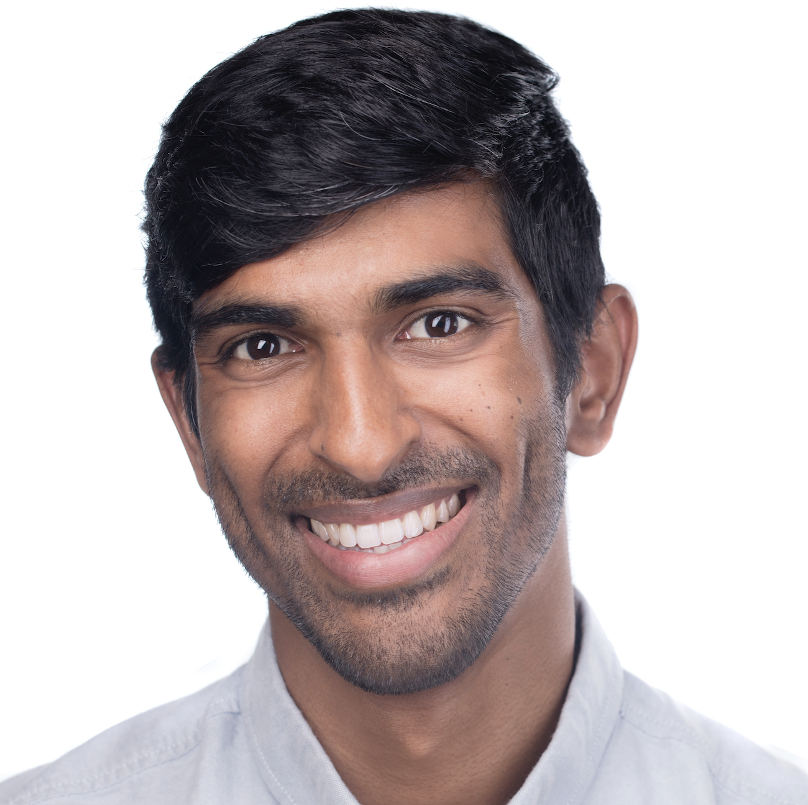
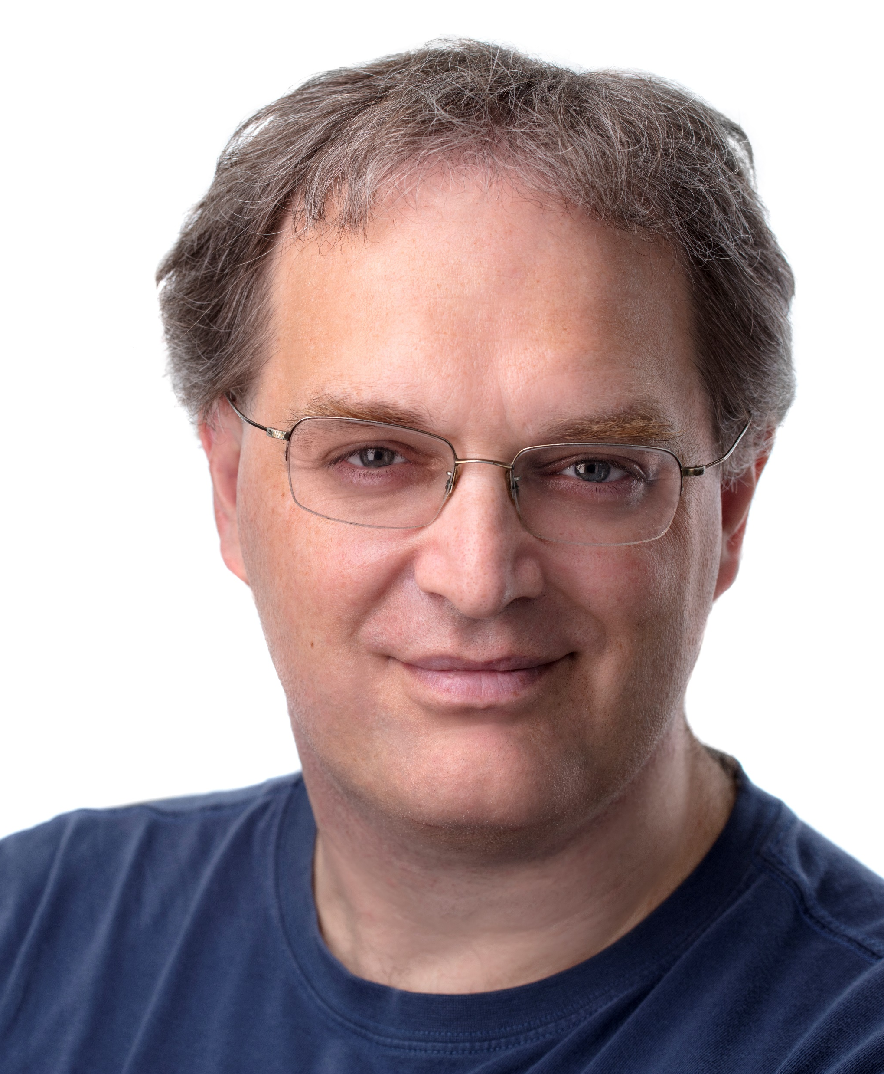
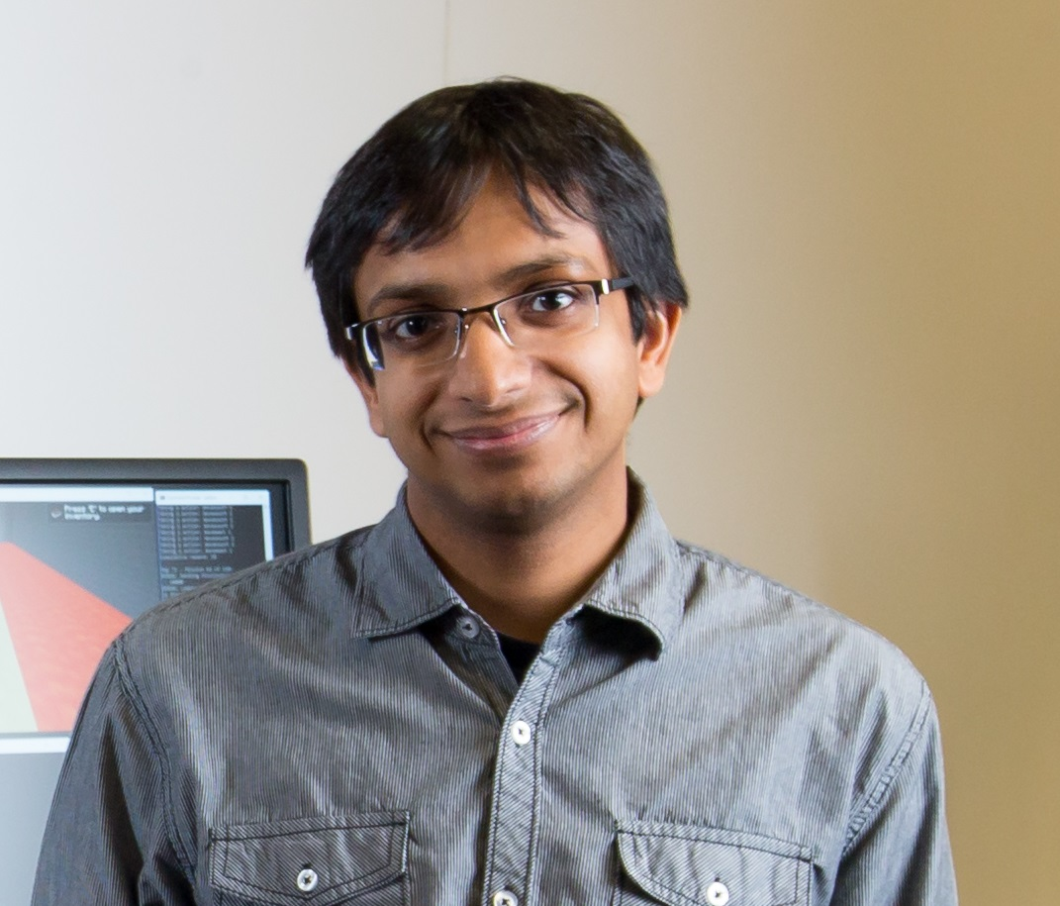
Theoretical Foundations of Reinforcement Learning
Alekh Agarwal
@Microsoft Research
Akshay Krishnamurthy
@Microsoft Research
John Langford
@Microsoft Research
FOCS 2020
http://hunch.net/~tforl

Slide 2
Tutorial Goals
A reference to key advances in reinforcement learning theory.
Describe key unresolved questions in RL theory.

Slide 3
Outline
Basics
Information Theory
The Optimization Approach
Latent State Discovery

Slide 4
Reinforcement Learning
Action
Action
Policy ?
Policy ?
Observation
Observation
Reward
Goal: maximize rewards

Slide 5
Why Reinforcement Learning?
Fundamental Natural problem
Your supervised learning problem is really a reinforcement learning problem. Frame it right for success.
Many applications can only be solved via Reinforcement Learning
Prediction | Decision
Click/no-click | Recommendations
Intent | Next utterance
Next video frame | North/East/West/South
Queue sizes | Server assignment

Slide 6
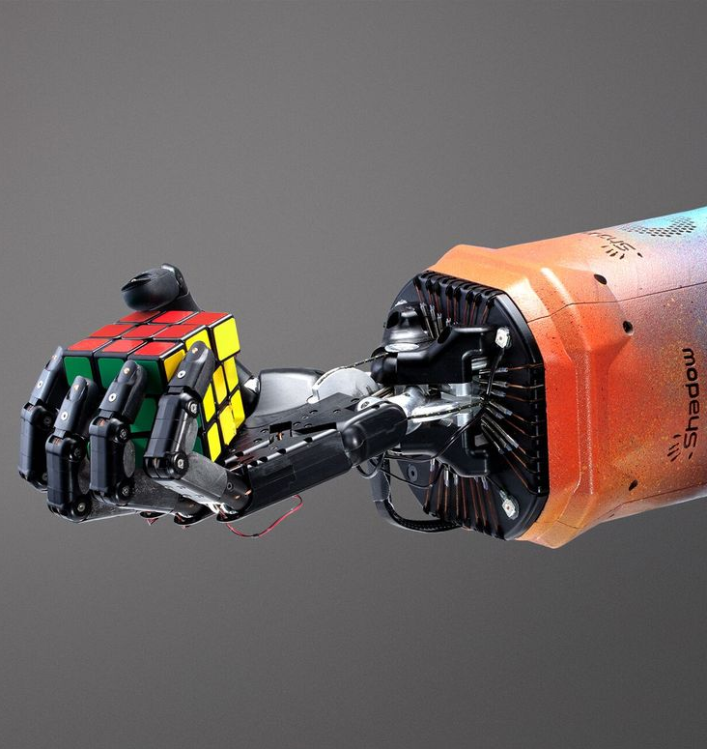
Examples

Slide 7
What is Reinforcement Learning more precisely?
Repeatedly
For $h = 1$ to $H$
See Observation $x$ // Trail view
Take Action $a$ // Left or right at the fork.
See Reward $r$ // Finding the mountain peak.
Goal: minimize regret to a policy class:
$$\max_{π∈Π}\sum_{\begin{aligned} \\ (x,\vec{r})\end{aligned}}{r_{π(x)}−r_{a}}$$
Policy class = Densenet with 192 layers, boosted decision tree, etc…

Slide 8
Is our goal possible?
Exponentially large tree, one rewarding leaf
Algorithm must try all leaves to find reward
${\left|𝒜\right|}^{H}$ sample complexity
Many refs: [KMN02] [KAL16] [DKWY20]
A consequence: Reinforcement Learning is a family of problems concerned with a core set of challenges but varying assumptions/settings.
Depth H
${\left|𝒜\right|}^{H}$ leaves

Slide 9
Example: Two different Horizons
For reasons of conceptual or notational simplicity sometimes care about:
1) success after H steps.
2) success $γ^{t}$ discounted $t$ steps into the future.
These are mostly unimportant variations.
Discount $γ≃$termination with probability $1−γ$ and no discount so
$$\frac{1}{1−γ}≃H$$

Slide 10
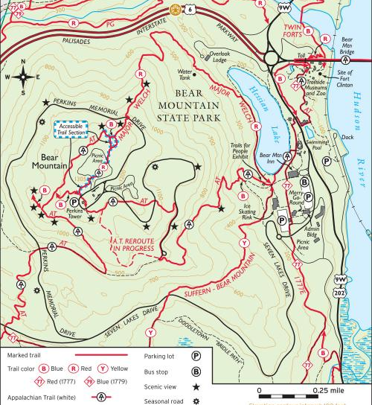
Challenge: Credit Assignment
“Which turn went wrong?”

Slide 11
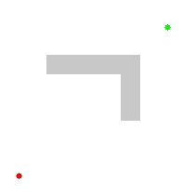
Example Solution: Dynamic Programming [B54, D59]

Slide 12
Challenge 2: Exploration
“How do you gather the data that you need to learn?”

Slide 13
Exploration Example Solution: $ε$-greedy
Exploit for performance
“Exploit”= use best known inference
“How much should I explore to discover how to best perform?”
x%
Policy
Explore to discover new things
“Explore” = try other alternatives

Slide 14
Challenge 3: Generalization
“How do you learn to act based on things never before seen?”

Slide 15
Generalization Example Solution: PAC-learning
1 | 1 | 5 | 4 | 3
7 | 5 | 3 | 5 | 3
5 | 5 | 9 | 0 | 6
3 | 5 | 2 | 0 | 0
Accurate digit classifier
Training examples
Training labels
Supervised Learner
2
[B36, VCY71, V84]

Slide 16
Key Technique: Learning Oracles/Reductions
PAC learning is poly-time for only simple function classes ☹
How can we reason about and aid the design of complex algorithms using complex function classes?
Observation: Heuristic search algorithms succeed commonly with enormously complex function classes.
Approach: Assume that we can solve any supervised/PAC-learning problem in unit time.
Result: Algorithms which can solve more complex problems in practice ☺

Slide 17
Exploration + Generalization = Contextual Bandits
Repeatedly:
See $x$
Choose $a$
See $r$
Minimize regret: $\max_{π∈Π } \sum_{(x,\vec{r}) }{r_{π\left(x\right)}−r_{a}}$ over IID sequence of $(x,\vec{r})$.

Slide 18
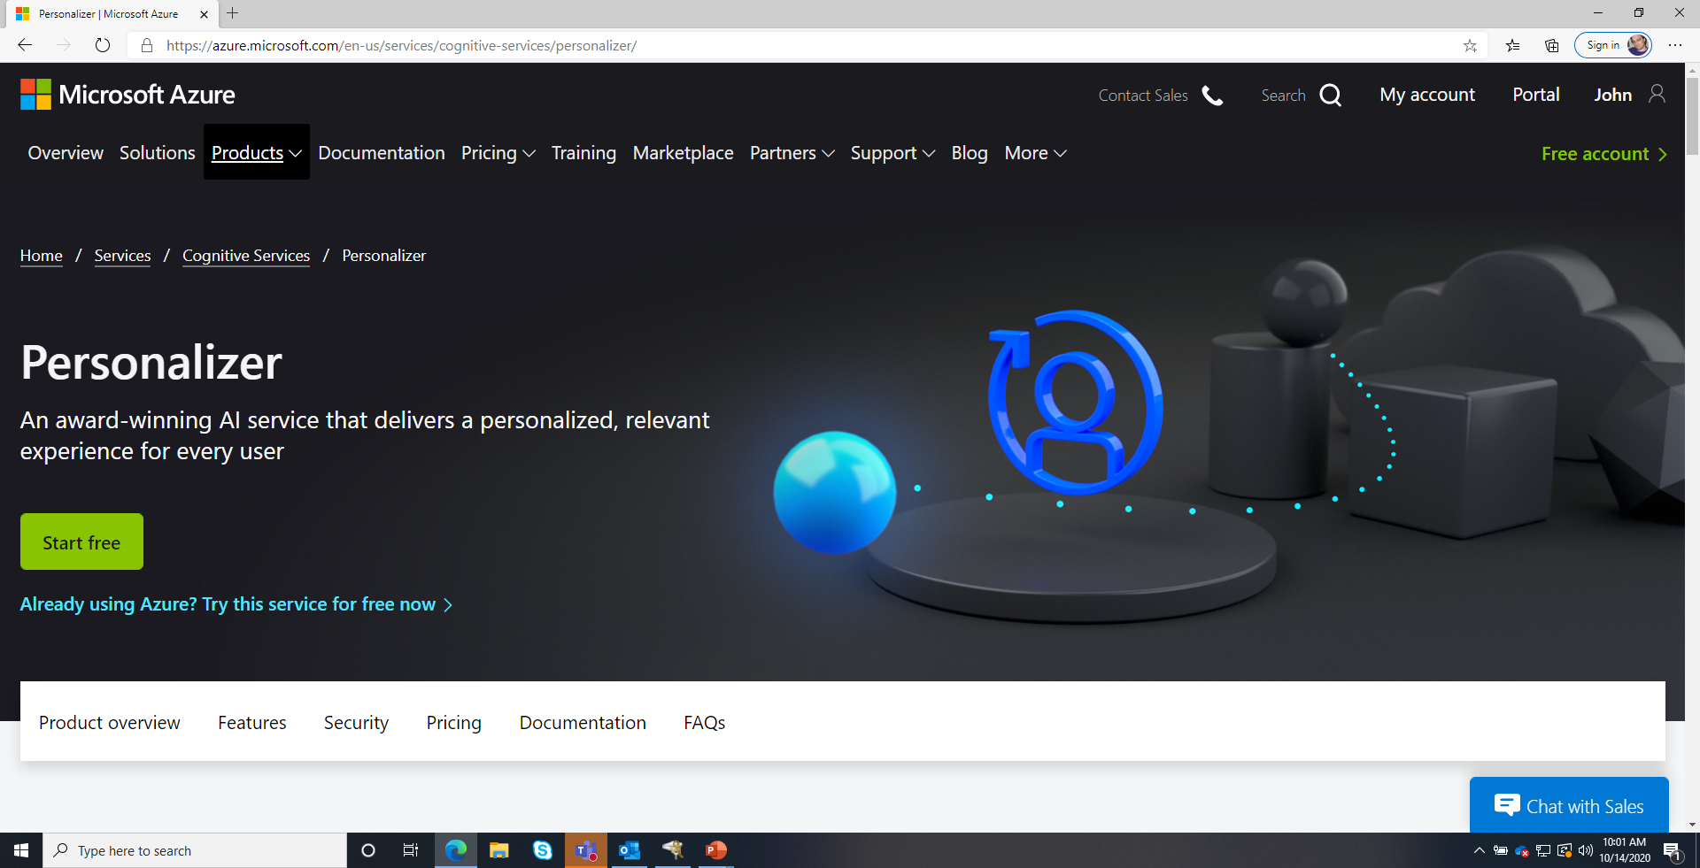
Contextual Bandit History
Thompson Sampling: [T33] First “bandit” style algorithm
EXP4: [ACFS95] Works even in adversarial settings
Epoch Greedy: [LZ07] Polytime given an oracle
Deployment: [LCLS10] Web recommendation application
Polytime: [DHKKLRZ11, AHKLLS14] Poly + statistically efficient given an oracle
GA Product: 2019 http://aka.ms/personalizer
Notes:
Maybe add a plot?

Slide 19
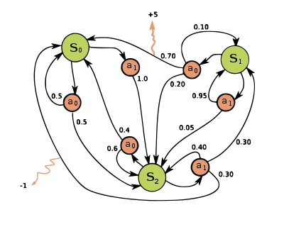
Credit Assignment + Exploration = MDP learning
Tabular Markov Decision Process:
Actions $A$, States $S$, Initial state $P(s)$, Transition table $T(s’|s,a)$, reward $R(r|s,a)$.
Typical algorithm:
Observe state $s$, action $a$, next state $s’$ transitions.
Build an imperfect model of the world $\hat{T}(s’|s,a)$, $\hat{R}(r|s,a)$.
Plan in the imperfect model to reach unobserved transitions and maximize reward.
Result: Poly$(S,A)$ samples/compute to success.

Slide 20
Tabular history
$E^{3}$: [KS98], Rmax [BF02], Polynomial time learning is possible.
Delayed-Q: [SLWLL06], linear in states is possible.
UCRL: [AJO08], near-optimal regret is possible.
UCB-B: [JABJ18], model-free near-optimal regret.

Slide 21
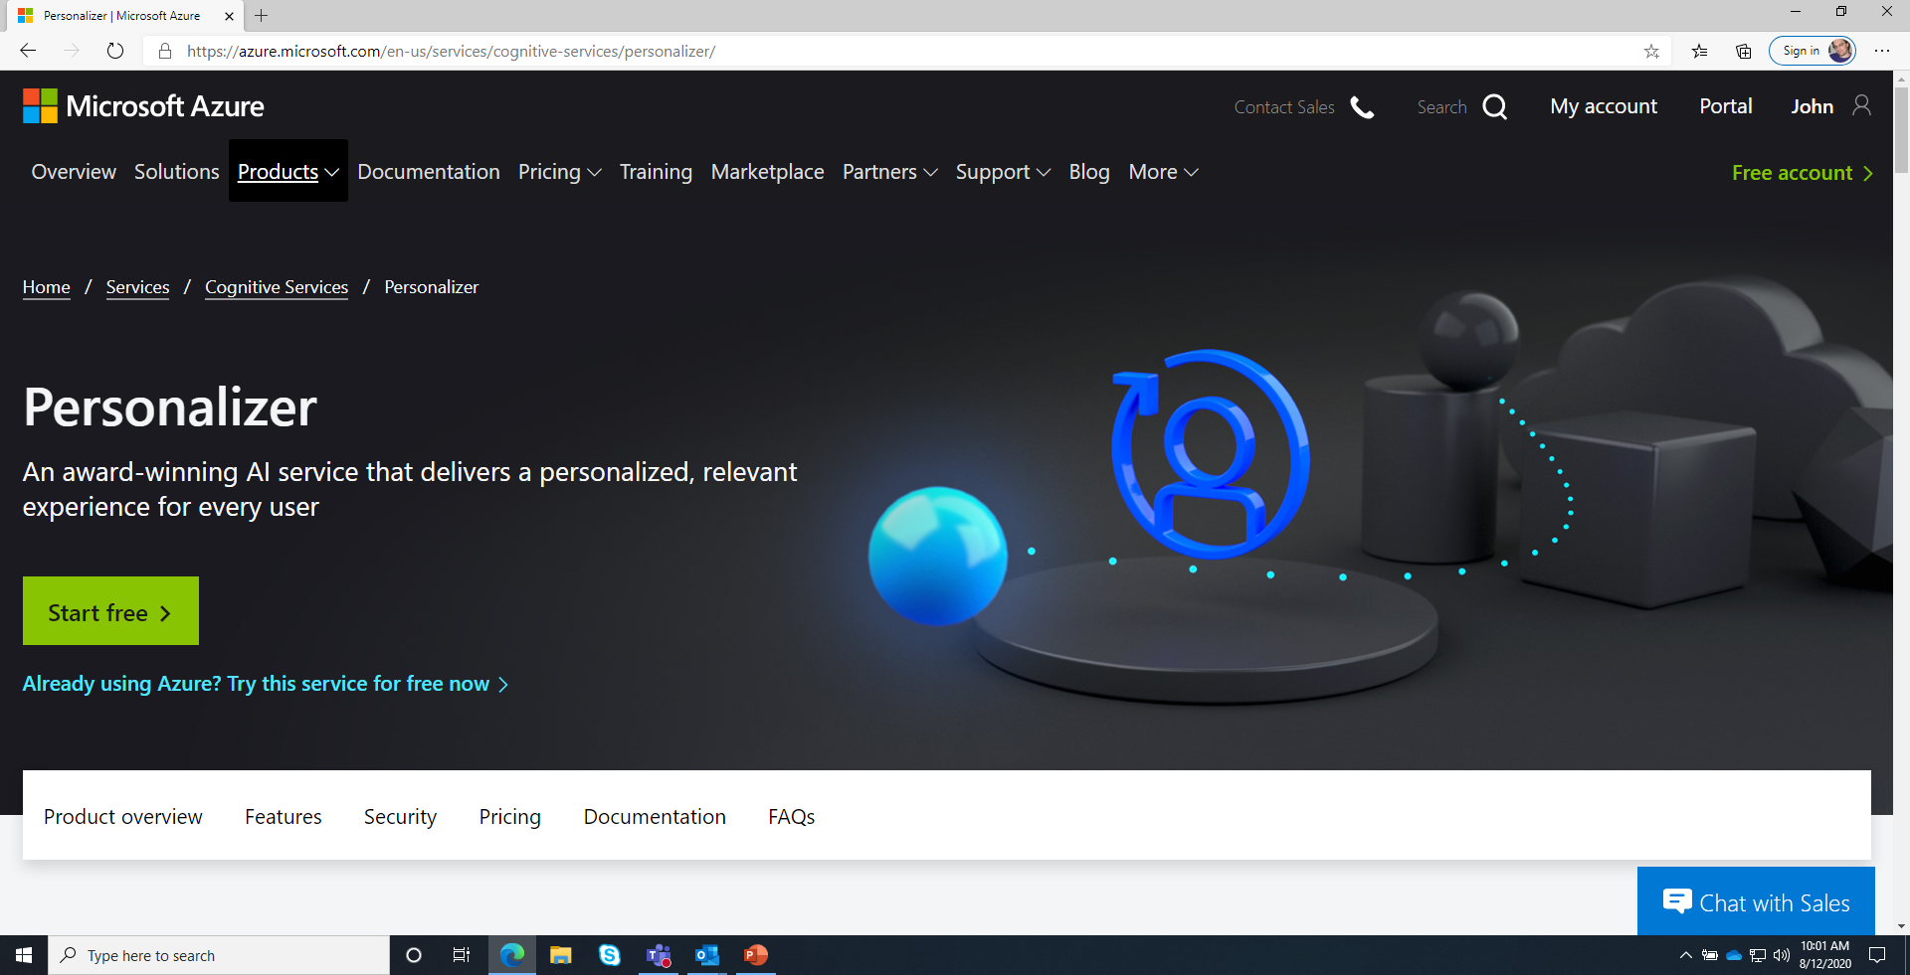
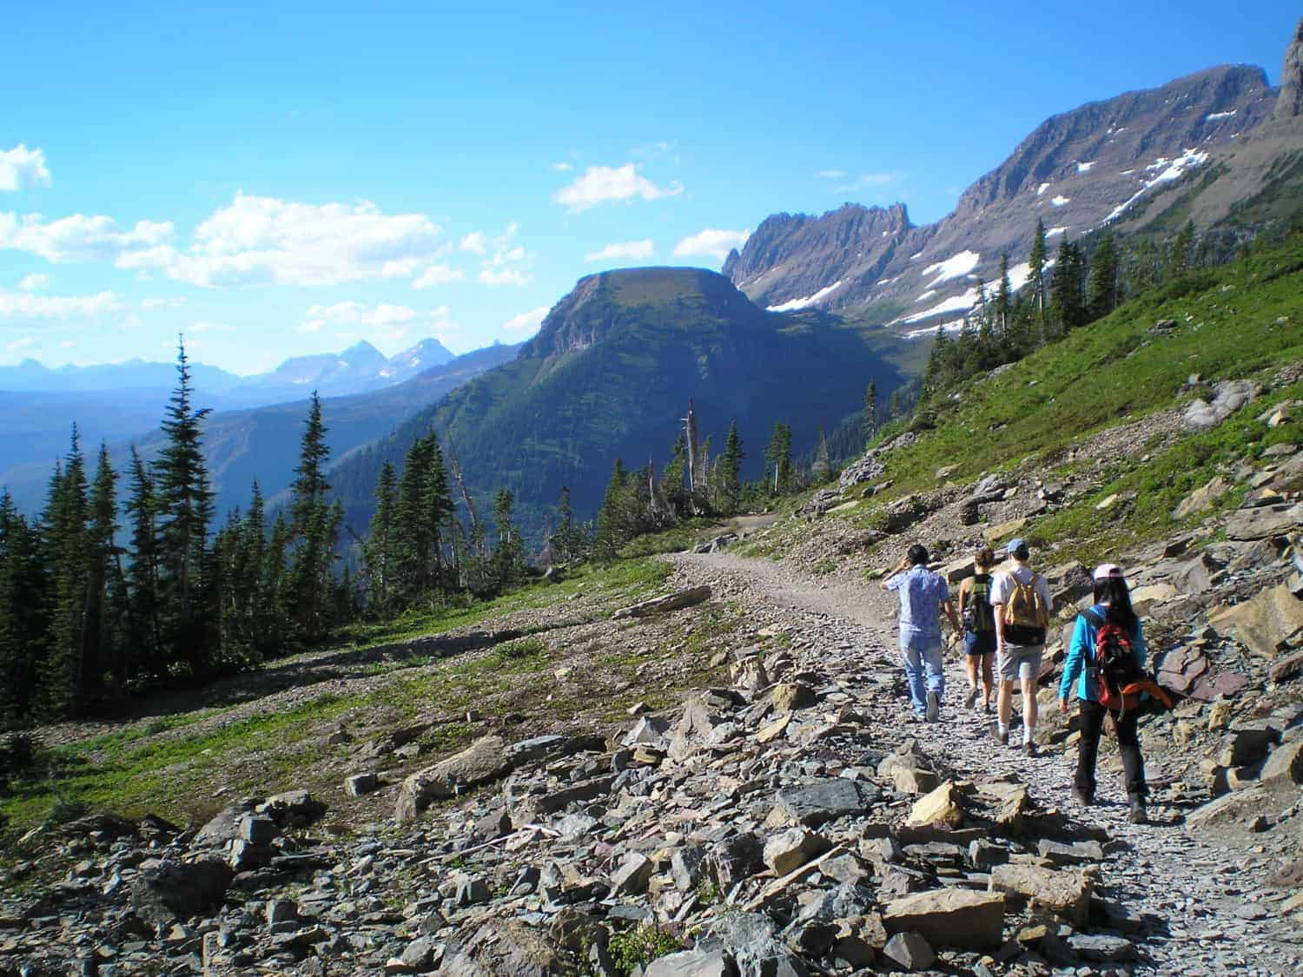
Reinforcement Learning problem
Policy Improvement
??
Generalization
Tabular
MDP Learning
Credit
Contextual Bandits
Exploration

Slide 22
Outline
Basics
Information Theory
The Optimization Approach
Latent State Discovery

Slide 23
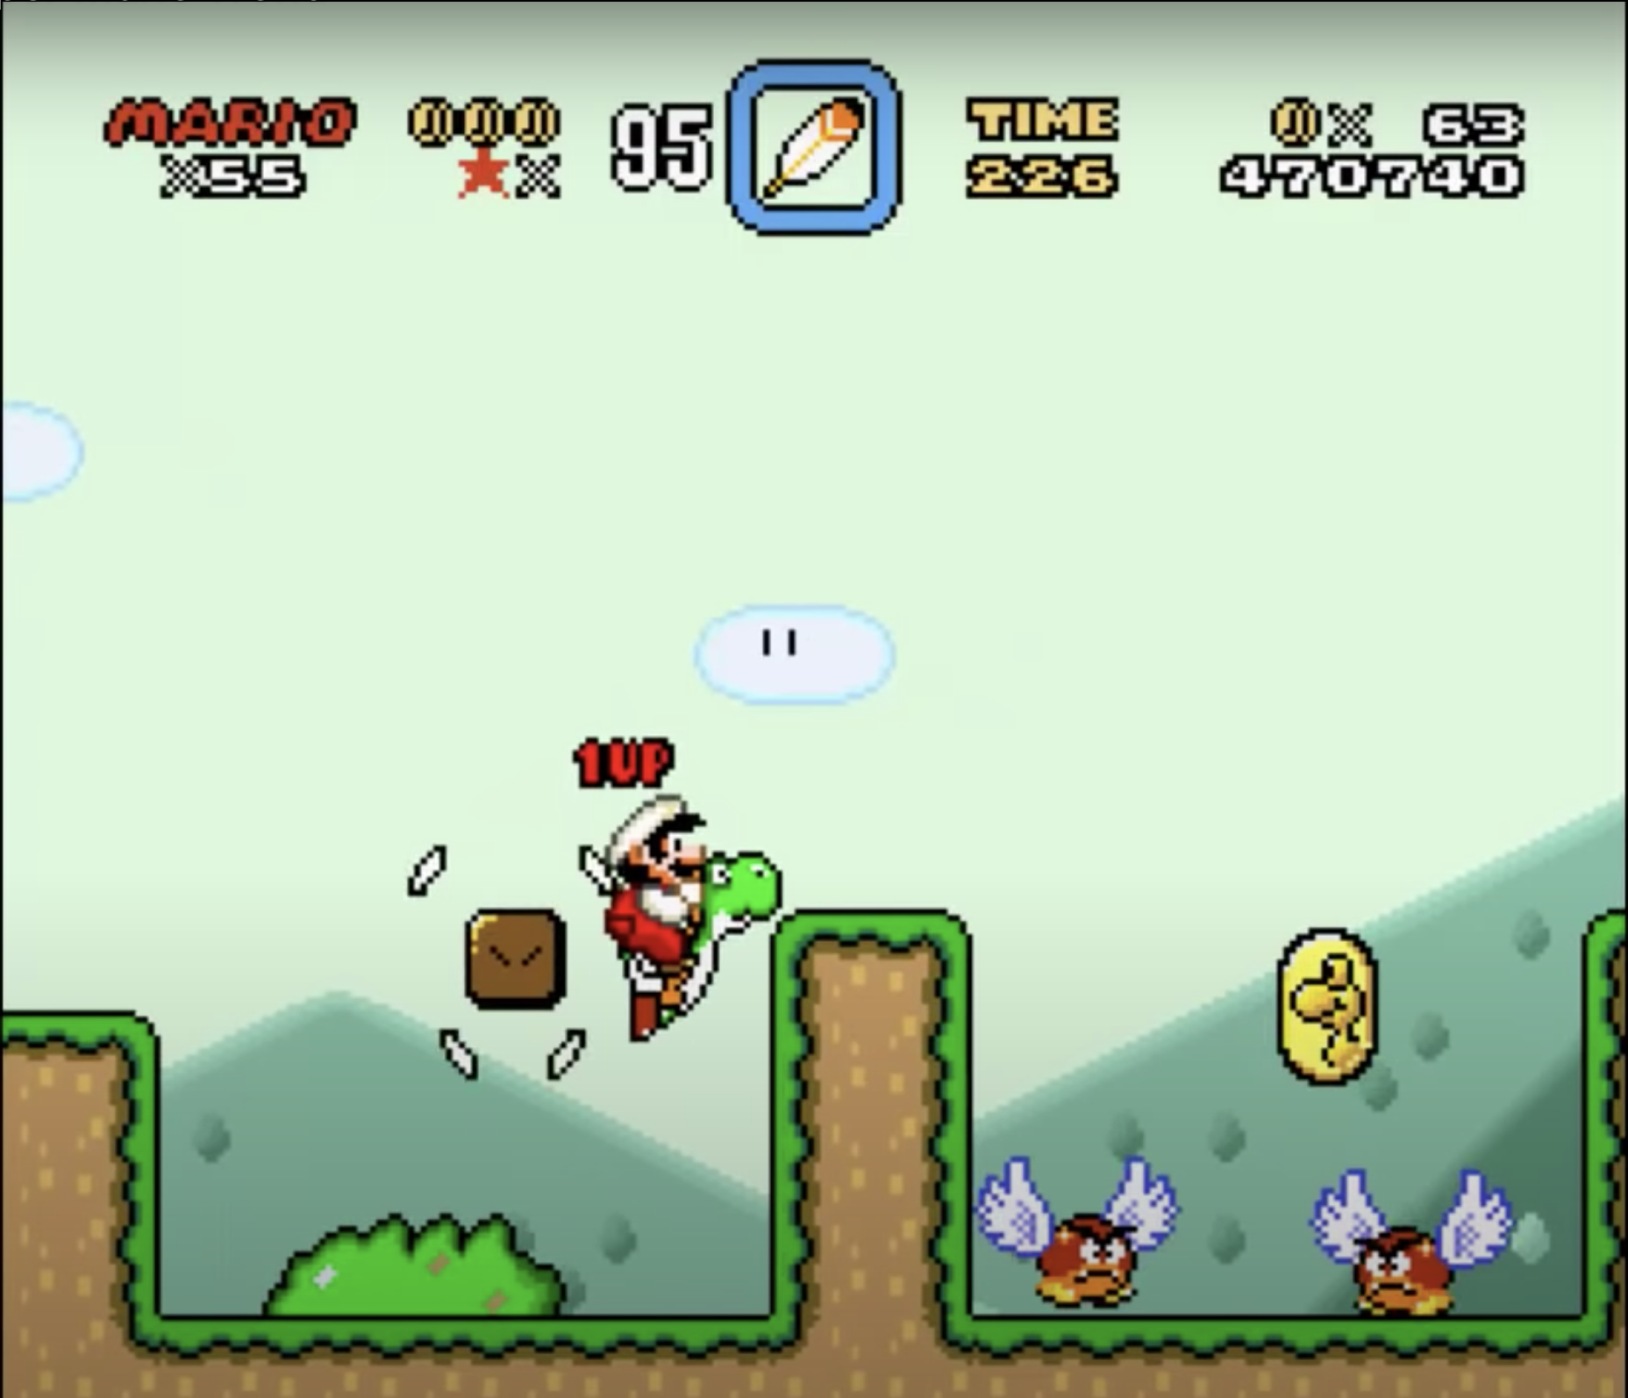
Set up
$$x_{1}$$
$$x_{2}$$
$$x_{3}$$
$$a_{1}$$
$$a_{2}$$
$$x_{1}∼P_{1}$$
For $h=1,…, H$:
observe $x_{h}∈𝒳$
take action $a_{h}∈𝒜$
observe reward $r_{h}∈[0,1]$
transition to $x_{h+1 }∼T(⋅∣x_{h},a_{h})$
Goal: Find policy $π: 𝒳→𝒜$ maximizing $V\left(π\right)≔ 𝔼_{π}\left[\sum_{h=1}^{H}{r_{h}}\right]$
PAC Learning: Output $\hat{π}$ with $V\left(\hat{π}\right)≥\max_{π} V\left(π\right)−ε$. Minimize number of episodes required.
Regret: Minimize $T⋅V^{⋆} −\{Learner reward\}$
Optimal value $V^{⋆ }$
Optimal policy $π^{⋆}$
Notes:
Define V^\star with a callout

Slide 24
Solution concepts
a
b
With large state space, search space $\{𝒳→𝒜\}$ is very large!
To generalize, we will restrict the space in which we search for solutions.
Policy search: Consider restricted policy class $Π⊂\{𝒳→𝒜\}$
E.g., multiclass linear classifiers: $x↦{argmax}_{a}θ_{a}^{⊤}x$
Value-based: Approximate action-value $Q∈𝒬⊂\{𝒳×𝒜→ℝ\}$
$Q_{h}^{⋆}\left(x,a\right)≔𝔼\left[\sum_{h^{′}=h}^{H}{r_{h^{′}}∣x_{h}=x, a_{h}=a, a_{h+1:H}∼π^{⋆} }\right]$
$=𝔼\left[r_{h}+\max_{a′} Q_{h+1}^{⋆}\left(x^{′},a^{′}\right)∣x_{h}=x, a_{h}=a\right]$
Model based: Approximate models $M∈ℳ$
c
$Q$ function encodes policy:
$$π_{Q}:x↦{argmax}_{a}Q(x,a)$$
$Q^{⋆}$ encodes optimal policy $π^{⋆}$
Notes:
Function approximation => generalization
Solution concepts – restricted class in which we will search for our solution concepts
Figure for Q^\star: 3x3 grid Q^\star is the shortest path in the graph (maybe re-use the dynamic programming figure)
Q^\star induces policy, model induces policy
Example of natural policy classes (linear separator, e.g.)

Slide 25
Statistical goal
PAC Learning: Output $\hat{π}$ with $V\left(\hat{π}\right)≥\max_{π∈Π} V\left(π\right)−ε$. Minimize number of episodes required.
Goal: $poly\left(\left|𝒜\right|, H, comp\left(ℱ\right), 1/ε\right)$ sample complexity
$comp\left(ℱ\right)= log \left|ℱ\right|$ for finite classes
$comp\left(ℱ\right)=d$ for $d$-dimensional linear predictors
No explicit dependence on $\left|𝒳\right|⇒$ generalization across states
Class of induced policies

Slide 26
RL is not like supervised learning
A contextual bandit problem
Repeat n times: sample $\left(x,a\right)∼𝒟$ reveal $y=Q^{⋆}(x,a)$
Solve $\hat{Q}= {argmin}_{Q∈ℱ} ∑{\left(Q\left(x_{i},a_{i}\right)−y_{i}\right)}^{2}$
Supervised learning guarantee:
$$𝔼_{𝒟}\left[{\left(\hat{Q}\left(x,a\right)−Q^{⋆}\left(x,a\right)\right)}^{2}\right]≤comp(ℱ)/n$$
What about policy performance?
Natural encoded policy is $\hat{π}:x↦{argmax}_{a} \hat{Q}(x,a)$
Problem: $\hat{Q}\left(x, \hat{π}\left(x\right)\right)≫Q^{⋆}\left(x,\hat{π}\left(x\right)\right)$ if unsupported by $𝒟$
$$𝒟$$
$$\hat{π}$$
Notes:
Link to the previous slide? In the search tree, every path has a different distribution over states.
Policies induce very different distributions
You don’t know which are good a priori.

Slide 27
The problem
“Distribution Shift”
States we evaluate $\hat{π}≠$ states we fit $\hat{Q}$
We require out-of-distribution generalization
Conceptual approaches to address this
Assume environment only has “a few” distributions
Assume $ℱ$ directly supports “extrapolation”
A combination of both
Unknown
$$\hat{π}$$
$$𝒟$$
Notes:
Does credit assignment have to be on here?

Slide 28
Distribution shift #1: Contextual Bandits
Assume $H=1, 𝒜$ finite, well-specified reward $f^{⋆}\left(x,a\right)=𝔼\left[r \right|x,a]∈ℱ$
Collect n samples $(x,a,r)$ with $a∼Unif\left(𝒜\right)$
Solve $\hat{f}= {argmin}_{f∈ℱ} ∑{\left(f\left(x_{i},a_{i}\right)−r_{i}\right)}^{2}$, define $\hat{π}\left(x\right)={argmax}_{a} \hat{f}(x,a)$
Proposition: $V\left(π^{⋆}\right)−V\left(\hat{π}\right)≤\sqrt{\frac{comp\left(ℱ\right)}{n}⋅|𝒜|}$
Intuition: All state-action distributions covered by just $\left|𝒜\right|$ of them
$$a_{1}$$
$$r_{1}$$
$$x$$
$$a_{2}$$
Effective # of distributions
Obvious extension to multi-step pays ${\left|𝒜\right|}^{H}$
Notes:
Not true in multi-step RL.
Maybe not a good example – Take all actions supports all distribution
All distributions in the span of |A| of them

Slide 29
Distribution shift #2: Linear bandits
Assume $H=1,$fixed starting state, well-specified linear reward $\left\langle θ^{⋆}, φ\left(a\right)\right\rangle =𝔼\left[r \right|a]$
$$φ(a_{1})$$
$$φ(a_{3})$$
$$φ(a_{2})$$
$$comp\left(ℱ\right)=d$$
Collect $n$ samples on an approximate basis
Proposition: $V\left(π^{⋆}\right)−V\left(\hat{π}\right)≤\sqrt{\frac{poly(d)}{n}}$
Intuition: Extrapolate predictions from basis to entire space
Approximate bases: Barycentric spanner [AK06], Volumetric spanner [HKM14]
No dependence on $\left|𝒜\right|$
Notes:
Check \sqrt{d^2/n}
Linear function approximation is only useful bc of linear assumption

Slide 30
Landscape of tractability
All of RL
Low Witness rank
Factored MDP
Low Bellman rank
Low rank MDP (unknown $φ$)
Low
Eluder
dimension
Low rank MDP (known $φ$)
Tabular
Block MDP

Slide 31
RL with linear functions
Recall: well-specified linear functions directly support extrapolation
Value based RL where $ℱ$ is linear functions of known feature map $φ\left(x,a\right)$
Most basic question: Is $Q^{⋆}∈ℱ$ sufficient?
Evidence leans no: insufficient in batch setting [WFK20], insufficient with many actions [WAS20]
Lesson: extrapolation not the only issue
Low rank MDP (or linear MDP): Rewards and transitions are linear in features
Implies $Q^{⋆}∈ℱ$ and enables credit assignment
$$T(x^{′}∣x, a)$$
$$φ(x,a)$$
$$μ(x^{′})$$
=

Slide 32
LSVI-UCB
Recall $Q_{h}^{⋆}(x,a)=𝔼\left[r_{h}+\max_{a′} Q_{h+1}^{⋆}\left(x^{′},a^{′}\right)∣x_{h}=x, a_{h}=a\right]$
Algorithm:
Optimistic dynamic programming
$${\hat{θ}}_{h}≔ {argmin}_{θ} ∑{\left(\left\langle θ,φ\left(x_{h},a_{h}\right)\right\rangle −r_{h} −\max_{a^{′}} {\hat{Q}}_{h+1}\left(x_{h+1}, a^{′}\right)\right)}^{2}$$
Define ${\hat{Q}}_{h}\left(x,a\right)=\left\langle {\hat{θ}}_{h},φ\left(x,a\right)\right\rangle + {bonus}_{h}(x,a)$
Collect data with greedy policy
Theorem: [JYWJ20] $\tilde{O}\left(\sqrt{d^{3}H^{3}T} \right)$ regret in $T$ rounds

Slide 33
LSVI-UCB Analysis
$${\hat{Q}}_{h}= {bonus}_{h}+ {error}_{h}+𝔼[r_{h}+{\hat{Q}}_{h+1}\left(x^{′},\hat{π}\left(x^{′}\right)\right)]$$
Optimistic regret decomposition: If $\hat{Q}≥Q^{⋆}$ pointwise then
$$Q_{h}^{⋆}\left(x,π^{⋆}\left(x\right)\right)−Q_{h}^{⋆}\left(x,\hat{π}\left(x\right)\right)≤{\hat{Q}}_{h}\left(x, \hat{π}\left(x\right)\right)−Q_{h}^{⋆}\left(x,\hat{π}\left(x\right)\right)$$
$$≤{bonus}_{h}\left(x,\hat{π}\left(x\right)\right)+ {error}_{h}\left(x, \hat{π}\left(x\right)\right)+𝔼\left[{\hat{Q}}_{h+1}\left(x^{′}, \hat{π}\left(x^{′}\right)\right)−Q_{h+1}^{⋆}\left(x^{′},π^{⋆}\left(x^{′}\right)\right)∣x, \hat{π}(x)\right]$$
If ${error}_{h}≤{bonus}_{h}$ pointwise then
$$Regret≤2⋅\sum_{h}{{bonus}_{h}}(x_{h}, \hat{π}\left(x_{h}\right))$$
Ensuring optimism: standard well-specified linear least squares analysis (almost).
Potential function: bonuses cannot be large forever
$${bonus}^{2}=φ^{⊤}Σ^{−1}φ, Σ←Σ+φφ^{⊤}$$
Open problem: Optimal rate in this setting? Computationally efficient approach?
Well-specified property ensured by low rank assumption
Notes:
Upper bound Q^\star and drop the \hat{Q} part.

Slide 34
Landscape of tractability
All of RL
Low Witness rank
Factored MDP
Low Bellman rank
Low rank MDP (unknown $φ$)
Low
Eluder
dimension
Low rank MDP (known $φ$)
Tabular
Block MDP

Slide 35
Eluder dimension
Combinatorial parameter that captures worst-case extrapolation
Point $z$ is $ε$-dependent on $z_{1},…,z_{n}$ if predictions on $z_{1},…,z_{n}$constrain prediction on $z$:
$$∀f,f^{′}:\sqrt{\sum_{i=1}^{n}{{\left(f\left(z_{i}\right)−f^{′}\left(z_{i}\right)\right)}^{2}}}≤ε⇒|f\left(z\right)−f′\left(z\right)|≤ε$$
Eluder dimension $dim(ℱ, ε)$ is the length of the longest independent sequence
Potential function: If bonus is large then point must be dependent on few disjoint subsequences
Can give $\sqrt{T}$-regret rates for bandits [RvR13]
RL requires more assumptions [WSY20]
Independent sub-histories
large bonus
Notes:
Drop the figure
Not sufficient on it’s own for multi-step RL

Slide 36
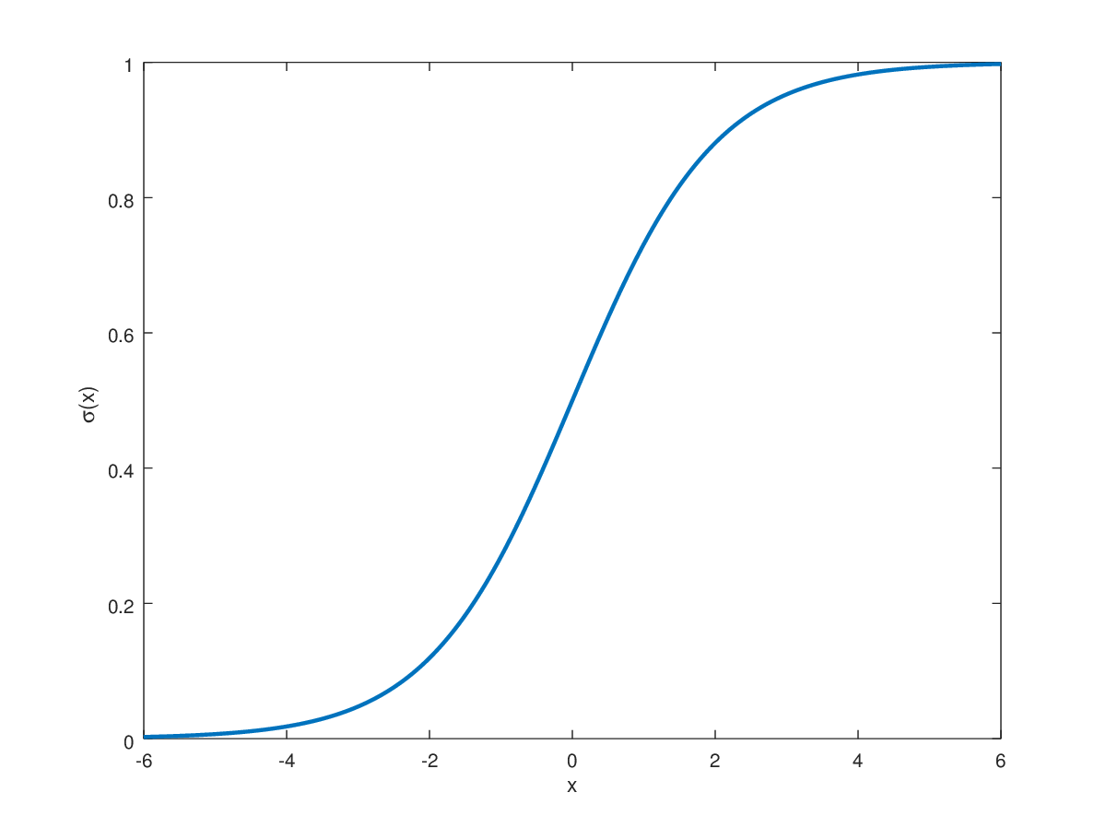
Discussion
When is Eluder dimension small?
Linear functions: O(d)
Generalized linear functions $f\left(x\right)↦σ(\left\langle θ, x\right\rangle )$, $σ$ smooth: O(d)
$exp(d)$ for ReLU: $f\left(x\right)↦max\{0,⟨θ, x⟩\}$ [LK]
Summary:
Eluder dimension is the most comprehensive theory for distribution-free extrapolation
But only known to be small for linear-ish classes
Open: What non-linear settings admit small Eluder dimension?

Slide 37
Landscape of tractability
All of RL
Low Witness rank
Factored MDP
Low Bellman rank
Low rank MDP (unknown $φ$)
Low
Eluder
dimension
Low rank MDP (known $φ$)
Tabular
Block MDP

Slide 38
Revisiting approach #1
$$T(x^{′}∣x, a)$$
$$φ(x,a)$$
$$μ(x^{′})$$
=
In low rank MDP, for any $π$ and any $g:𝒳→ℝ$
$$𝔼_{π}g\left(x_{h}\right)=𝔼_{π}∫T\left(x_{h}\right|x_{h−1}, π(x_{h−1})) g(x_{h}) d(x_{h})$$
$$=⟨𝔼_{π}φ\left(x_{h−1}, π\left(x_{h−1}\right)\right), ∫μ\left(x_{h}\right)g\left(x_{h}\right)d(x_{h})⟩$$
All expectations live in a d-dimensional space $⇒$ ”a few” distributions!
$$ℰ_{h}\left(π, f\right) ≔ 𝔼\left[f\left(x_{h}, a_{h}\right)−r_{h}−f\left(x_{h+1 }, a_{h+1 }\right)| x_{h}∼π, a_{h:h+1}∼π_{f}\right]$$
In low rank MDP $ℰ_{h}\left(π,f\right)=⟨α\left(π\right), β\left(f\right)⟩$
Bellman rank: $\max_{h}{rank\left(ℰ_{h}\right)}$
This captures both approaches, as we’ll see
Alternative def where $a_{h}∼π$
Action-value functions
$$ℰ_{h}\left(π, f\right)$$
For any $f$
Roll-in policies
Notes:
Low rank MDP, even if you don’t know the features, or if you were using non-linear functions

Slide 39
Sufficiency of bellman rank
Assume: $Q^{⋆}∈ℱ$ (realizability)
Assume: Bellman rank $≤M$
Theorem: [JKALS17] OLIVE learns an $ε$ sub-optimal policy with sample complexity:
$$\tilde{O}\left(M^{2} \left|𝒜\right|H^{3} comp(ℱ)/ε^{2}\right)$$
With alternative definition, can eliminate dependence on $|𝒜|$
Can also get $\sqrt{T}$-regret rate [DPWZ20]

Slide 40
OLIVE
Recall $ℰ_{h}\left(π, f\right) ≔ 𝔼\left[f\left(x_{h}, a_{h}\right)−r_{h}−f\left(x_{h+1 }, a_{h+1 }\right)| x_{h}∼π, a_{h:h+1}∼π_{f}\right]$
Optimistic guess for $V^{⋆}$
Repeat
Pick surviving $\hat{f}∈ℱ$ to maximize $𝔼\left[ f\left(x_{1},π_{f}\left(x_{1}\right)\right)\right]=:V^{f}(π_{f})$
Collect trajectories with $π_{\hat{f}}$, estimate $V\left(π_{\hat{f}}\right)$
Output $π_{\hat{f}}$ if$V\left(π_{\hat{f}}\right)≈$ $V^{\hat{f}}(π_{\hat{f}})$
Eliminate all $f$ for which $ℰ_{h}\left(π_{\hat{f}}, f\right)≠0$ at some $h$
First observation: Each iteration requires $poly\left(\left|𝒜\right|, H, comp\left(ℱ\right)/ε\right)$ samples
Key issue: How many iterations?
Check our guess
Refine the search space

Slide 41
OLIVE Analysis
Recall $ℰ_{h}\left(π, f\right) ≔ 𝔼\left[f\left(x_{h}, a_{h}\right)−r_{h}−f\left(x_{h+1 }, a_{h+1 }\right)| x_{h}∼π, a_{h:h+1}∼π_{f}\right]$
Claim 1: $Q^{⋆}$ is never eliminated
Bellman optimality equation: $Q^{⋆}\left(x,a\right)=𝔼\left[r+Q^{⋆}\left(x^{′}, π^{⋆}\left(x^{′}\right)\right) ∣ x,a\right]$
Claim 1 + Optimism $⇒$ near-optimality upon termination
Claim 2: Telescoping performance decomposition $V^{f}\left(π_{f}\right)−V\left(π_{f}\right)= \sum_{h=1}^{H}{ℰ_{h}(π_{f}, f)}$
$⇒\hat{f}$ eliminated
Claim 3: Iterations $≤MH$
Real proof uses volumetric argument
(Similar to Ellipsoid analysis)
$$Q^{⋆}$$
$$\hat{f}$$
$ℰ_{h}$ matrix
$$π_{1}$$
$\hat{f}$ survived previous rounds
$$π_{2}$$
$$π_{\hat{f}}$$
$≠0$ by claim 2
Notes:
Do we need to use the performance difference?

Slide 42
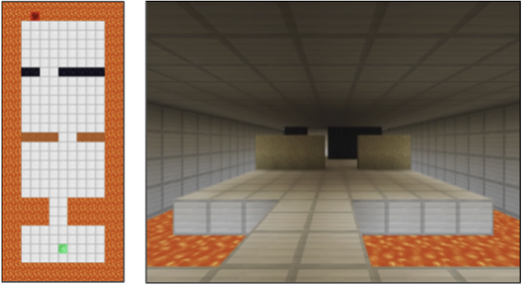
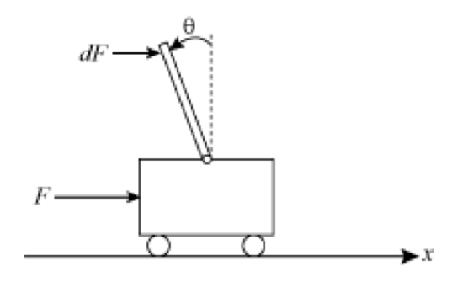
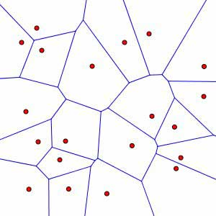
Examples (overview)
T
=
Linear completeness
dimension
Tabular MDP
# states
Block MDP
# hidden states
Low rank MDP
dimension
Some models with memory
Linear quadratic control
poly(state+action dim)
State aggregation
poly(abstract states, actions)
Exponential tree
$${\left|𝒜\right|}^{H}$$

Slide 43
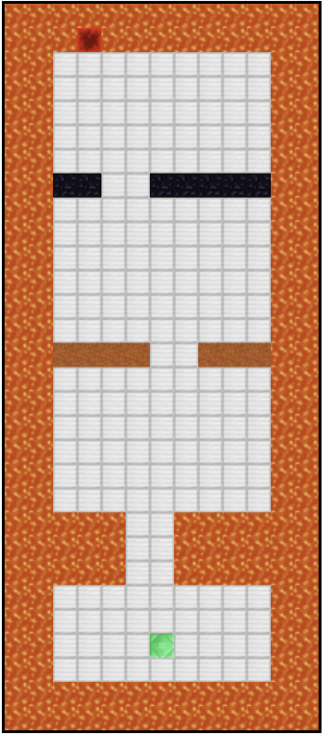
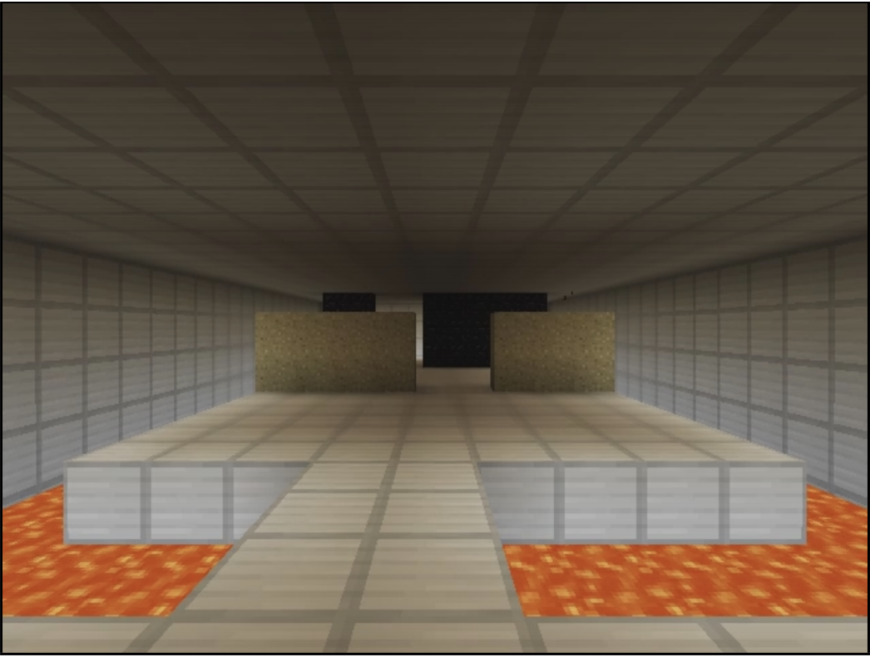
Example: block MDP
$$s_{1}$$
$$s_{2}$$
Discrete hidden state space
Observations from emission distributions
Roll-in policy induces distribution over hidden state
$$ℰ\left(π, f\right)=\sum_{s}{P^{π}\left(s\right)𝔼\left[f\left(x,a\right)−r −f\left(x^{′},π_{f}\left(x^{′}\right)\right) ∣ x∼s, a∼π_{f}\right]}$$
Bellman rank = # of hidden states, for any function class $ℱ$
(OLIVE also requires realizability of $Q^{⋆}$)
$$x_{1}$$
$$x_{2}$$
$$a_{1}$$
$$a_{2}$$
More in part 4

Slide 44
Example: low rank MDP
$$T(x^{′}∣x, a)$$
$$φ(x,a)$$
$$μ(x^{′})$$
=
$$ℰ_{h}(π, f)=⟨𝔼_{π}φ\left(x_{h−1}, π\left(x_{h−1}\right)\right), ∫μ\left(x_{h}\right)err\left(x_{h},f\right)d(x_{h})⟩$$
More in part 4
Bellman rank = rank of transition operator, for any function class $ℱ$
$⇒$ low rank MDP with “feature selection” or unknown $φ$ is statistically tractable

Slide 45
Example: linear completeness
Bellman backup operator
For any $θ$, $∃w$ such that
$$\left(𝒯θ\right)\left(x,a\right)≔ 𝔼\left[r+\max_{a^{′}}\left\langle θ, φ\left(x^{′},a^{′}\right)\right\rangle ∣ x,a\right]=⟨w, φ\left(x,a\right)⟩$$
Standard assumption in analysis of dynamic programming algorithms
$$ℰ_{h}\left(π, θ\right)=𝔼_{π}\left[\left\langle θ, φ\left(x,a\right)\right\rangle −r −\max_{a^{′}}⟨θ, φ\left(x^{′},a^{′}\right)⟩\right]$$
$$=𝔼_{π}\left[⟨θ−w, φ\left(x,a\right)⟩\right]$$
$$=⟨θ−w, 𝔼_{π}φ\left(x,a\right)⟩$$
Exploits structure of function class $ℱ$, not environment dynamics
More like extrapolation argument for linear classes [ZLKB20]
Summary: Bellman rank captures structure of environment and $ℱ$
Uses alternative definition

Slide 46
Summary of value-based methods
Linear methods
Positive results require more than realizability, e.g., completeness conditions
Current thinking is that realizability alone insufficient
Nonlinear methods require some dynamics assumptions for low Bellman rank
Two conceptual approaches for handling distribution shift
Do neural networks (or other classes) enable extrapolation?
Optimal rates for extrapolation approaches?
$$a_{1}$$
$$r_{1}$$
$$x$$
$$a_{2}$$

Slide 47
Landscape of tractability
All of RL
Low Witness rank
Factored MDP
Low Bellman rank
Low rank MDP (unknown $φ$)
Low
Eluder
dimension
Low rank MDP (known $φ$)
Tabular
Block MDP

Slide 48
Factored MDP
State is a d-dimensional discrete vector. Transition operator factorizes:
$$T\left(x^{′}\right|x,a)=\prod_{i=1}^{d}{T_{i}\left(x′\left[i\right]\right|x\left[pa\left(i\right)\right], a)}$$
Binary state vars: unfactored $2^{2d}\left|𝒜\right|$ parameters, factored $2^{L+1}d\left|𝒜\right|$ parameters, $L=\max_{i} |pa\left(i\right)|$.
Statistics: $\tilde{O}(\sqrt{\#\left\{params\right\}⋅T})$ regret with known parent structure. Can also learn structure
Computation:
Planning with a known model is computationally hard
Optimal policy cannot be represented by a poly-sized circuit
Statistical separation:
[SJKAL19] For value-based methods, realizability alone is insufficient
What combinatorial models are computationally tractable?

Slide 49
A complexity measure
For model-based RL, assume class $ℳ$ of candidate dynamics models, and $T∈ℳ$
Parallel development to Bellman rank
$$𝒲_{h}\left(π, M\right)=𝔼\left[{\left\|M\left(⋅ ∣ x_{h},a_{h}\right)−T\left(⋅ ∣ x_{h}, a_{h}\right)\right\|}_{TV} ∣x_{h}∼π, a_{h}∼π_{M} \right]$$
Witness rank = $\max_{h} rank(𝒲_{h})$
Witness rank $≤$ Bellman rank (for $ℱ= plan\left(ℳ\right)$)
Theorem: [SJKAL19] Sample complexity $poly\left(witness rank, \left|𝒜\right|,H, comp(ℳ)\right)$ achievable
Factored MDP: $witness rank≤\#\left\{params\right\}$
Model-based needs strong realizability conditions, but can succeed where value-based fails.

Slide 50
Up next
Policy optimization methods (Alekh Agarwal)
Latent dynamics modeling (John Langford)
Thanks!
akshaykr@microsoft.com

Slide 51
Outline
Basics
Information Theory
The Optimization Approach
Latent State Discovery

Slide 52
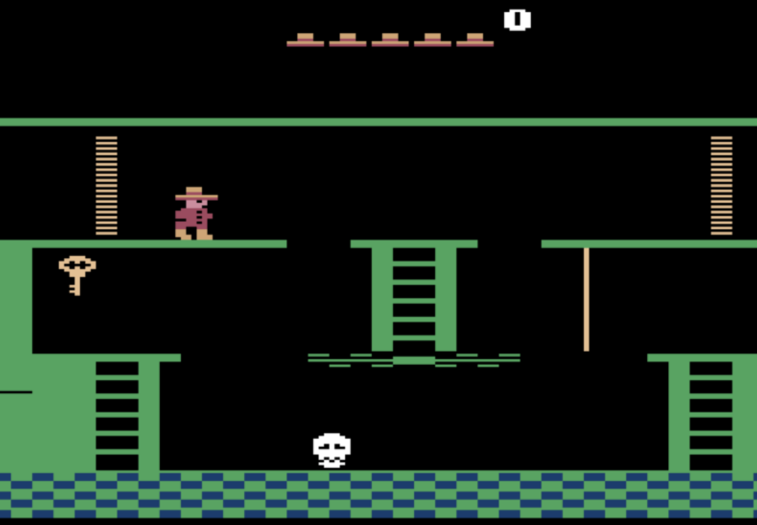
Policy Optimization
Why?
An “end-to-end” gradient-based approach that directly optimizes the task at hand
Easy to use with deep learning
Deep Learning + Policy Optimization
Likely a critical component to all interactive learning systems.
Main obstacle to success?
Lack of robustness due to poor exploration

Slide 53
Outline
Basics
Information Theory
The Optimization Approach
Policy optimization preliminaries
Convergence properties for tabular representations
Convergence properties with function approximation
Adding exploration
Latent State Discovery

Slide 54
RL as optimization
$γ∈\left(0,1\right).$Effective horizon $H=1/(1−γ)$
Discounted MDP $(𝒳,𝒜,R,T,γ)$
Let us consider the PAC goal:
$$\max_{θ}{V(π_{θ})}=E^{π_{θ}}\left[\sum_{t}^{∞}{γ^{t}}r\left(x_{t},a_{t}\right)\right]$$
The policy optimization approach:
How to iteratively update $θ_{t}$ through (stochastic) gradient methods?
All actions drawn according to $π_{θ}$
Key questions:
What is the optimization landscape?
Role of exploration and parameterization?
Convergence and sample complexity of (stochastic) gradient methods?

Slide 55
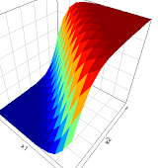
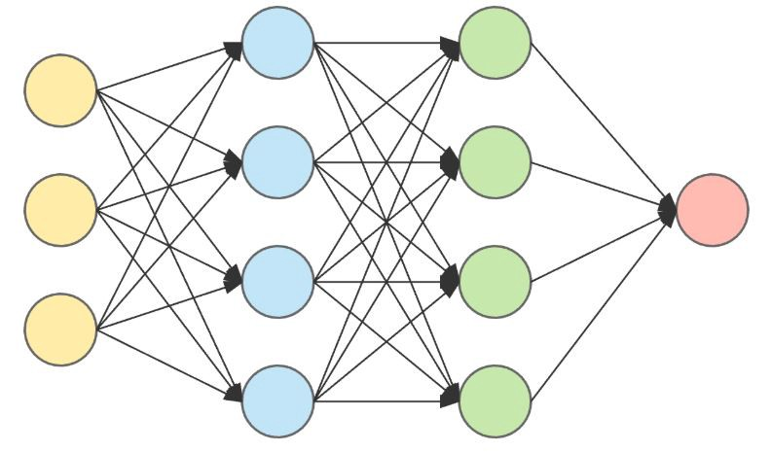
Stochastic policies
Policy $π_{θ} :𝒳→Δ(𝒜)$
Amenable to gradient based optimization
A common softmax form: $π_{θ}\left(a | x\right)∝exp⁡(f_{θ}\left(x,a\right))$
Tabular: $f_{θ}\left(x,a\right)=θ_{x,a}$
Linear: $f_{θ}\left(x,a\right)=θ^{T}φ(x,a)$
Neural: $f_{θ}\left(x,a\right)=NN(x,a;θ)$
Gaussian: $f_{θ}\left(x,a\right)= |\left|φ\left(x,a\right)−g_{θ}\left(x,a\right)\right|{\left.​\right|}^{2}$
One parameter per state, action. Fully expressive
State | $$a_{1}$$ | $$a_{2}$$
$$x_{0}$$ | 0.5 | 0.5
$$x_{1}$$ | 0.2 | 0.8
$$x_{2}$$ | 0.9 | 0.1
Control settings. $g_{θ}$ can take any of the above forms

Slide 56
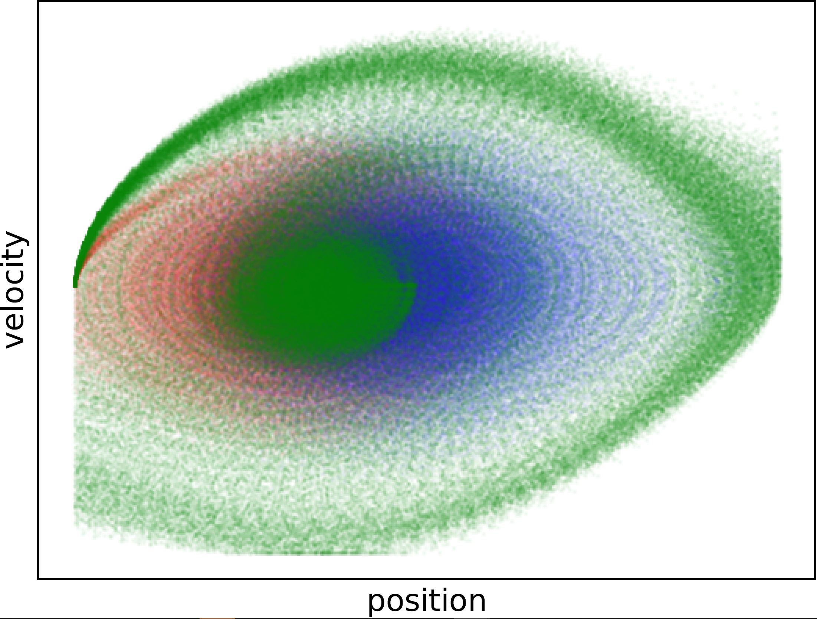
State distributions and value functions
All actions drawn according to $π$
State distribution of a policy $π$:
$$d_{x_{0}}^{π}\left(x\right)=\left(1−γ\right)\sum_{t=0}^{∞}{γ^{t}{Pr}^{π}\left(x_{t}=x \right|x_{0})}$$
$d_{μ}^{π}(x)$ when $x_{0}∼μ$.
Similarly define $d_{x_{0},a_{0}}^{π}(x,a)$ with $d_{x_{0}}^{π}(x,a)$ when $a_{0}∼π\left(⋅\right|x_{0})$.
Value functions of $π$:
$V^{π}\left(x_{0}\right)=\frac{1}{1−γ}E_{x,a∼d_{x_{0}}^{π}}\left[r\left(x,a\right)\right]$ and $Q^{π}\left(x,a\right)=E\left[r\left(x,a\right)+γV^{π}\left(x^{′}\right)\right| x,a]$

Slide 57
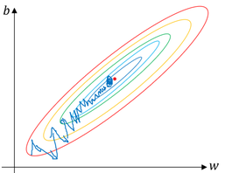
Policy gradient methods
Optimization problem: $\max_{θ}{V^{π_{θ}}(x_{0})}$
First-order updates on value of policy
$$θ_{t+1}=θ_{t}+η∇_{θ}V^{\left(t\right)}(x_{0})$$
Policy gradient theorem [Williams ‘92, Sutton et al., ‘99]
$$∇_{θ}V^{π_{θ}}\left(x_{0}\right)= E_{x,a∼d_{x_{0}}^{π_{θ}}} [∇_{θ}\log{π_{θ}\left(a | x\right){ Q}^{π_{θ}}(x,a)]}$$
Estimate using trajectories for stochastic gradient ascent (REINFORCE, Williams ‘92)
$V^{π}$ with $π=π_{θ_{t}}$

Slide 58
Policy optimization history
First algorithms: REINFORCE [W ‘92], Actor-critic [KT ‘00], Function approx. [SMSM ’00]
Empirical progress: Trust-region (TRPO, PPO), variance reduction, regularization (SAC)
Convergence to stationary points under smoothness [SMSM ‘00, RM ’51]
Improvement upon a given policy, not global optimum
KL ‘02, DLM ‘09, RGB ‘11, RB ‘14, CKADL ’15, SVGBB ’17, CYRB ‘19, BSH ’19, CKA ’20
Convergence to global optimum: Conservative Policy Iteration (CPI) [KL ‘02]
Requires additional assumptions on exploration and parameterization
SLMJA ‘15, SWDRK ‘17
TZAL ‘18

Slide 59
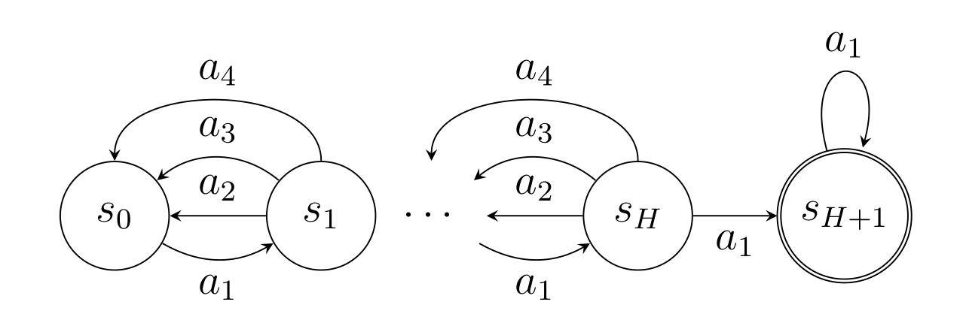
Optimization landscape
Fact: There exist MDPs where $V^{π_{θ}}\left(x_{0}\right)$ is a non-concave function of $θ$
Stationary points do not induce good policies
Not an issue of samples, exact gradients also scale with state visitation!
Theorem [AKLM ’20]
There is an MDP where $O(H)$-order gradients have norm at most $exp⁡(−H)$ and where the corresponding policy gets $exp⁡(−H)$ expected reward

Slide 60
Optimization challenges in RL
How to fix?
Favorable state distributions (given or constructed)
Favorable reward structures (imitation learning, reward shaping)
Supervised learning:
Gradient descent “generally works” in practice, not sensitive to initialization
Saddle points not a problem…
Reinforcement learning:
Many RL problems have “very flat” regions
Small gradients due to poor exploration

Slide 61
The initial state distribution
Optimization problem: $\max_{θ}{V^{π_{θ}}(x_{0})}$
Assume: Initial state$x_{0}∼μ$, e.g.: uniform over states in chain
First-order updates on value of policy
$$θ_{t+1}=θ_{t}+η∇_{θ}V^{\left(t\right)}(μ)$$
Policy gradient theorem [Williams ‘92, SMSM ‘00]
$$∇_{θ}V^{π_{θ}}\left(μ\right)= E_{x,a∼d_{μ}^{π_{θ}}} [∇_{θ}\log{π_{θ}\left(a | x\right){ Q}^{π_{θ}}(x,a)]}$$

Slide 62
What we will address today?
Convergence and sample complexity of (stochastic) gradient methods?
Role of exploration and parameterization?
How to construct favorable initial distributions?

Slide 63
Outline
Basics
Information Theory
The Optimization Approach
Policy optimization preliminaries
Convergence properties for tabular representations
Convergence properties with function approximation
Adding exploration
Latent State Discovery
State | $$a_{1}$$ | $$a_{2}$$
$$x_{0}$$ | 0.5 | 0.5
$$x_{1}$$ | 0.2 | 0.8
$$x_{2}$$ | 0.9 | 0.1

Slide 64
Asymptotic convergence
State | $$a_{1}$$ | $$a_{2}$$
$$x_{0}$$ | 0.5 | 0.5
$$x_{1}$$ | 0.2 | 0.8
$$x_{2}$$ | 0.9 | 0.1
Tabular softmax policies: $π_{θ}\left(a | x\right)∝\exp\left(θ_{x,a}\right)$
Policy gradient algorithm: $θ_{t+1}=θ_{t}+η∇_{θ}V^{\left(t\right)}(μ)$
(see also MXSS ‘20 for rates under stronger assumptions)
Converges to globally opt as all states, actions have non-zero probability
Slow as opt is deterministic, $θ$ grow to $∞$
Conjecture: Convergence is exponentially slow in the worst case
Theorem [AKLM ’20]
Suppose $μ\left(x\right)>0$ for all $x∈𝒳$ and stepsize $η≤\frac{{\left(1−γ\right)}^{3}}{8}$. For all $x$, $V^{\left(t\right)}\left(x\right)→V^{⋆}(x)$ as $t →∞$.

Slide 65
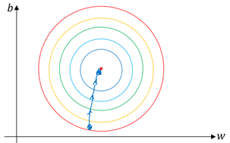
Natural Policy Gradient
[Kakade ’01] introduced Natural Policy Gradient (also BS ‘03, PS ‘08)
Uses a Fisher information based preconditioner
Inspiration for practical approaches like TRPO and PPO
Simple form for tabular softmax parameterization:
$$θ_{t+1}=θ_{t}+\frac{η}{1−γ}Q^{(t)} \text{and} π_{t+1}\left(a | x\right)∝π_{t}\left(a | x\right) exp(ηQ^{\left(t\right)})$$
Like multiplicative weights, but in a non-concave maximization setting

Slide 66
Convergence of Natural Policy Gradients
State | $$a_{1}$$ | $$a_{2}$$
$$x_{0}$$ | 0.5 | 0.5
$$x_{1}$$ | 0.2 | 0.8
$$x_{2}$$ | 0.9 | 0.1
Theorem [AKLM ‘20]
Using $μ=δ_{x_{0}}$ and $θ_{0}=0$, setting $η={\left(1−γ\right)}^{2}\log{|𝒜|},$ for all $t$ we have $$V^{⋆}\left(x_{0}\right)−V^{\left(t\right)}\left(x_{0}\right)≤\frac{2}{{\left(1−γ\right)}^{2} t}$$
Dimension free convergence, no dependence on$\left|𝓧\right|,\left|𝓐\right|$
No reliance on state coverage under $μ$
Some related works: EDKM ’09, NGJ ‘17, GSP’19, SEM ’19, AYBBLSW ‘19
Assumes exact gradients (no sampling)
Still require exploratory $μ$ for sample complexity

Slide 67
Proof ideas
Performance difference lemma [KL ‘02]:
$$V^{π}\left(x_{0}\right)−V^{π^{′}}\left(x_{0}\right)=\frac{1}{1−γ}E_{x∼d_{x_{0}}^{π}}E_{a∼π\left(⋅ | x\right)}\left[Q^{π^{′}}\left(x,a\right) −V^{π^{′}}(x)\right]$$
Linearize regret using above lemma instead of concavity
Yields $\frac{1}{\sqrt{t}}$ rate almost immediately by multiplicative weights analysis
Lower bound per-step improvement for fast rate

Slide 68
Outline
Basics
Information Theory
The Optimization Approach
Policy optimization preliminaries
Convergence properties for tabular representations
Convergence properties with function approximation
Adding exploration
Latent State Discovery

Slide 69
Linear parameterization
Linear softmax policies: $π_{θ}\left(a | x\right)∝\exp\left(θ^{T}φ\left(x,a\right)\right)$
Can we compete with the best linear policy?
$$θ^{⋆} = \underset{θ}{argmax} V^{π_{θ}}(x_{0})$$
Assume $\left|\left|θ\right|\right|≤1$ and $\left|\left|φ\left(x,a\right)\right|\right|≤1$

Slide 70
NPG for linear parameterization
NPG updates: $θ^{t+1}=θ^{t}+ηw^{t}$ and
$$π^{t+1}\left(a | x\right)∝π^{t}\left(a | x\right) exp⁡(ηw^{t}⋅φ\left(x,a\right))$$
Define $w_{⋆}^{t}=argmin_{w} E_{x,a∼d^{(t)}}\left[{\left(Q^{\left(t\right)}\left(x,a\right) −w⋅φ\left(x,a\right)\right)}^{2}\right]$
State-action distribution of $π^{t}$ starting from exploratory $μ$
$$L\left(w;θ^{t},d^{\left(t\right)}\right)$$

Slide 71
NPG for general parameterization
NPG updates: $θ^{t+1}=θ^{t}+ηw^{t}$
Recall: $π_{θ}\left(a | x\right)∝\exp\left(f_{θ}\left(x,a\right)\right)$
Define $w_{⋆}^{t}=argmin_{w} E_{x,a∼d^{(t)}}\left[{\left(Q^{\left(t\right)}\left(x,a\right) −w⋅∇_{θ}f_{θ^{t}}(x,a)\right)}^{2}\right]$
Gradients of $\log{π}$ provide features for approximating values

Slide 72
Convergence in linear case: Key Quantities
Goes to 0 with enough samples
Estimation error:
$$E\left[L\left(w^{t};θ^{t},d^{\left(t\right)}\right)−L\left(w_{⋆}^{t};θ^{t},d^{\left(t\right)}\right)\right]≤ε_{stat}$$
Transfer error under $d^{⋆}$:
$$E[L\left(w_{⋆}^{t};θ^{t}, d^{⋆})\right]≤ε_{bias}$$
Relative condition number:
$\frac{w^{T}Σ_{d^{⋆}}w}{w^{T}Σ_{μ}w} ≤κ<∞$ where $Σ_{d}=E_{x,a∼d}\left[φ\left(x,a\right)φ{\left(x,a\right)}^{T}\right]$
State-action distribution of $π^{θ^{⋆}}$ starting from exploratory $μ$
Initial state-action distribution. Holds if $μ$ has full-rank covariance, for example.

Slide 73
Convergence in linear case
Theorem [AKLM ‘20]
With $θ^{0}=0$ and $η=\sqrt{2\log{|𝒜|}/T}$, we have $$V^{⋆}\left(x_{0}\right)−\max_{t}{V^{\left(t\right)}\left(x_{0}\right)}≤\sqrt{\frac{2\log{|𝒜|}}{{\left(1−γ\right)}^{2}T}}+\sqrt{\frac{4|𝒜|κε_{stat}}{{\left(1−γ\right)}^{3}}}+\sqrt{\frac{4|𝒜|ε_{bias}}{{\left(1−γ\right)}^{2}}}$$
Slow $\frac{1}{\sqrt{T}}$ rate compared with the tabular case

Slide 74
Convergence in linear case
Theorem [AKLM ‘20]
With $θ^{0}=0$ and $η=\sqrt{2\log{|𝒜|}/T}$, we have $$V^{⋆}\left(x_{0}\right)−\max_{t}{V^{\left(t\right)}\left(x_{0}\right)}≤\sqrt{\frac{2\log{|𝒜|}}{{\left(1−γ\right)}^{2}T}}+\sqrt{\frac{4|𝒜|κε_{stat}}{{\left(1−γ\right)}^{3}}}+\sqrt{\frac{4|𝒜|ε_{bias}}{{\left(1−γ\right)}^{2}}}$$
Depends on exploratory initial distribution through $κ$ when $ε_{stat}>0$
Can always design $μ$ so $κ≤d$, independent of number of states
(L$ö$wner-John ellipsoid)
Can bound $ε_{stat}=O\left(\frac{1}{\sqrt{N}}\right)$ when using $N$ samples to fit $w^{t}$

Slide 75
Convergence in linear case
Theorem [AKLM ‘20]
With $θ^{0}=0$ and $η=\sqrt{2\log{|𝒜|}/T}$, we have $$V^{⋆}\left(x_{0}\right)−\max_{t}{V^{\left(t\right)}\left(x_{0}\right)}≤\sqrt{\frac{2\log{|𝒜|}}{{\left(1−γ\right)}^{2}T}}+\sqrt{\frac{4|𝒜|κε_{stat}}{{\left(1−γ\right)}^{3}}}+\sqrt{\frac{4|𝒜|ε_{bias}}{{\left(1−γ\right)}^{2}}}$$
$ε_{bias}$ is 0 if $Q^{\left(t\right)}\left(x,a\right)=w_{⋆}^{t}⋅φ(x,a)$ for all $x,a$
e.g.: tabular, low-rank MDP in $φ$
Measures quality of the chosen representation, more generally
Similar result holds for the non-linear version

Slide 76
Understanding transfer error
A crude upper bound
$$L\left(w_{⋆}^{t};θ^{t},d^{⋆}\right)≤\max_{x,a}{\frac{d^{⋆}\left(x,a\right)}{d^{\left(t\right)}\left(x,a\right)}} L\left(w_{⋆}^{t};θ^{t},d^{\left(t\right)}\right)$$
$$≤\max_{x,a}{\frac{d^{⋆}\left(x,a\right)}{(1−γ)μ\left(x,a\right)}} L\left(w_{⋆}^{t};θ^{t},d^{\left(t\right)}\right)$$
Weakest conditions for RL under a fixed $μ$ (see e.g. Scherrer ‘14)
Incremental updates give better robustness to modeling errors
Question: Other general characterizations for a small transfer error?

Slide 77
Outline
Basics
Information Theory
The Optimization Approach
Policy optimization preliminaries
Convergence properties for tabular representations
Convergence properties with function approximation
Adding exploration
Latent State Discovery

Slide 78
Adding exploration to PG methods
Consider linear parameterizations
Want: exploratory distribution with small relative condition number
Key idea: Find policies that reach diverse directions and use their mixture
How to find such policies?

Slide 79
Policy Cover-Policy Gradient (PC-PG)
Policy cover: A set of exploratory policies discovered so far
For $i=1,2,…,$
Let $Π_{i}$ be the current policy cover and $ρ_{i}=Unif(Π_{i})$
If ($φ(x,a)$ has coverage under $ρ_{i}$ : $φ{\left(x,a\right)}^{T}Σ_{ρ_{i}}^{−1}φ\left(x,a\right)≤κ$)
Mark $x,a$ as known
Define bonus $b_{i}\left(x,a\right)=1(\left(x,a\right) is not known)$ (c.f. LSVI-UCB)
$π^{i+1}=NPG(ρ_{i}, r+b_{i})$
Update cover: $Π_{i+1}=Π_{i}∪\left\{π^{i+1}\right\}$

Slide 80
PC-PG Theory for low-rank MDPs
Let $π^{⋆}=\text{argma}{\text{x}}_{π∈Π_{linear}}V^{π}(s_{0})$
Let $\tilde{d}$ be the intrinsic dimension of the low-rank MDP ($O\left(d\right)$ for finite dim)
Extends beyond low-rank MDPs under a transfer error condition
Related recent results in CYJW ’20, ESRM ‘20
Practical combination with deep RL: replace NPG with PPO and neural policies
Theorem [AHKS20]
For all low-rank MDPs in $φ$, PC-PG uses samples and computation $poly\left(\tilde{d},\frac{1}{ε},\frac{1}{1−γ}, W,\ln{\frac{1}{δ}}\right)$ and w.p. $≥1−δ$ outputs a policy $π$ satisfying $$V^{π}\left(s_{0}\right)≥V^{π^{⋆}}\left(s_{0}\right)−ε$$

Slide 81
PC-PG versus LSVI-UCB
PC-PG handles infinite dimensions
LSVI-UCB does better data reuse and has better sample complexity
PC-PG more robust to model misspecification
$E_{x∼d^{⋆}}\max_{a}{ε_{misspec}(x,a)}$ versus $\max_{x,a}{ε_{misspec}\left(x,a\right)}$
Departure from linearity in $T$ and $R$ at $x,a$

Slide 82
Open questions: Better algorithms
Can we quantify the benefits of optimization tricks?
Variance reduction, acceleration, adaptive learning rates, …
Connections with online learning. Better potential functions?

Slide 83
Open questions: Misspecified settings
PG methods seem most stable to modeling assumption failures
e.g.: transfer error
Isolated examples: misspecified linear, state aggregation, other examples
Limits? Alternate notions (e.g. $Q^{⋆}$ preserving aggregations)
Robustness-efficiency tradeoffs?, e.g. with data reuse and stepsizes

Slide 84
Open questions: Exploration and Improvement
Always compete with a reference policy $π_{0}$, globally opt under assumptions
Suppose you need $f(ε)$ samples to find globally $ε$-optimal policy when $φ\left(x,a\right)$ induces a linear MDP. How to find a policy $π$ using $f(ε)$ samples, such that:
Either MDP is linear in $φ$ and $π$ is globally optimal, or
$V\left(π\right)≥V\left(π_{0}\right)−ε$*
*assuming $π_{0}∈Π$, or we need other approximation terms (e.g. RB ‘14)

Slide 85
Outline
Basics
Information Theory
The Optimization Approach
Latent State Discovery

Slide 86
The Latent State Approach
Policy Improvement
??
Generalization
Tabular
MDP Learning
Credit
Contextual Bandits
Can we add generalization to MDP learning by discovering
and leveraging latent state efficiently?
Exploration

Slide 87
Can we efficiently handle Block MDP?
All of RL
Low Witness rank
Factored MDP
Low Bellman rank
Low rank MDP (unknown $φ$)
Low
Eluder
dimension
Low rank MDP
(known $φ$)
Tabular
Block MDP

Slide 88
The Block MDP Problem [DKJADL19]
Repeatedly
For $h = 1$ to $H$
See Observation $x$ // Trail view
Take Action $a$ // Left or right at the fork.
See Reward $r$ // Finding the mountain peak.
Block Markov Decision Process
States $S$, Actions $A$, Initial States $P(s)$, Transition Matrix $T(s’|s, a)$, reward $R(r|s, a)$, Horizon $H$, Observations $q(x|s)$ with $x$ disjoint over $s$.
Assumption: Realizable supervised policy oracle
For each cost sensitive classification learning problem $D(x,\vec{c})$ a policy class $Π$ contains the optimal solution, and an oracle returns in unit time: $arg \min_{π∈Π}\sum_{\left(x,\vec{c}\right)∈S}{c_{π\left(x\right)}}$
Notes:
Add concrete example here, Maybe give example of policy class

Slide 89
Some things that do not work in general
Bottleneck autoencoder and declare the bottleneck a state.
[THFSCDSDA17]
Encoding “quality” is maximized by predicting pure noise bit.
Predict previous action through bottleneck from previous and current observation. [PAED17]
{$s_{1},s_{2}\},\text{\{}s_{3},s_{4}\}→a_{1}$
{$s_{1},s_{2}\},\text{\{}s_{5},s_{6}\}→a_{2}$
$$\text{\{}s_{3},s_{4}\},\text{\{}s_{7},s_{8}\}→a_{1}$$
$\text{\{}s_{5},s_{6}\},\text{\{}s_{7},s_{8}\}→a_{2}$
Yet there exists a policy which can always reach $s_{7}$.
“Bisimulation” [GDG03, LWL06]: Alias “states” with the same dynamics & rewards.
Statistically intractable to learn. [MJTS19, Appendix B]

Slide 90
Homer [MHKL19]
For each horizon $h=1$ to $H$
Explore: Several times, for each latent state $s$ reachable with $h−1$ steps,
Use homing policy $π_{s}$ to find observation $x$ generated by latent state $s$
Use random action $a$
Make next observation $x′$
Abstract:
Learn to predict whether $x′$ swapped
$\left(p,φ \right)={argmin}_{p,φ} {\hat{E}}_{((x,a,x^{′}),y)} {\left(p\left(φ\left(x\right),a,φ\left(x′\right)\right)−y\right)}^{2}$
Home: For each value of bottleneck $s=φ(x′)$
Learn homing policy $π_{s}$ maximizing chance of $s$ given homing policies
Return Homing Policies
$$(\left(x,a,x^{′}\right),1)$$
$$(x,a,x^{′})$$
$$\left(\left(x,a,Uniform\left(x^{′}\right)\right),0\right)$$

Slide 91
Homer results
Theorem
$∀$Block MDPs where every state can be visited with high probability, If learning oracles for $Π,\left(p,φ\right)$ work with probability $1−δ$ can learn $ε$ optimal policy with Poly $(\left|A\right|,\left|S\right|,\log\left|F\right|,\log\left|Π\right|, log \frac{1}{δ},\frac{1}{ε}, H)$ samples.
Rich observations + deep learning $⇒$ Covering set of policies
Covering set of policies $⇒$ efficiently learn to optimize any reward function

Slide 92
Why does Homer work?
Backward Kinematic Inseparability
$x_{1}^{′}$ , $x_{2}^{′}$ are backwards KI if $∀u$ $\frac{T\left(x_{1}^{′} | x,a\right)u\left(x,a\right)}{\sum_{\tilde{x},\tilde{a}}{T\left(x_{1}^{′} | \tilde{x},\tilde{a}\right)u\left(\tilde{x},\tilde{a}\right)}}=\frac{T\left(x_{2}^{′} | x,a\right)u\left(x,a\right)}{\sum_{\tilde{x},\tilde{a}}{T\left(x_{2}^{′} | \tilde{x},\tilde{a}\right)u\left(\tilde{x},\tilde{a}\right)}}$
Lemma
If $x_{1}^{′}$ , $x_{2}^{′}$ Backwards Kinematic Inseparable then $∀π_{1},π_{2}$ $\frac{P_{π_{1}}(x_{1}^{′})}{P_{π_{2}}(x_{1}^{′}) }=\frac{P_{π_{1}}(x_{2}^{′})}{P_{π_{2}}(x_{2}^{′}) }$

Slide 93
What’s common in latent state decoding?
Repeatedly:
Explore: easily explored things.
Abstract: latent state space.
Cover: set of hard-to-reach things.

Slide 94
What about latent low rank MDP learning?
All of RL
Low Witness rank
Factored MDP
Low Bellman rank
Low rank MDP (unknown $φ$)
Low
Eluder
dimension
Low rank MDP
(known $φ$)
Tabular
Block MDP

Slide 95
Learning latent low rank MDP?[AKKS20]
FLAMBE
For each horizon h=1 to H
Explore: Several times, for each covering policy $π$ execute for h-1 steps to observe $x$, then act randomly for $a$ and observe $x’$.
Abstract: maximize $\sum_{\left\{x,a,x^{′}\right\}}{log φ\left(x,a\right)μ(x^{′})}$
Cover: Maximize range of $φ\left(x,a\right)$ when finding new covering policies
$$T(x^{′}∣x, a)$$
$$φ(x,a)$$
$$μ(x^{′})$$
=
Theorem
$∀$latent low rank MDPs, if learning oracles work, exploration succeeds after Poly $(\left|A\right|,d,\log\left|Φ\right|,\log\left|Μ\right|, log \frac{1}{δ},\frac{1}{ε}, H)$ samples.

Slide 96
Learning linear dynamics? [MFSMSKRL20]
RichID-CE (start)
Explore:
Many times, act $k$ times $a\sim N(0,I)$ and to observe $x$
Abstract: find
$\hat{h}=arg \min_{h} \sum_{a}{{\left(h\left(x\right)−a\right)}^{2}}$
$\hat{f}\left(x\right)=\hat{E}\hat{h}\left(\vec{a}\right)\hat{h}{\left(\vec{a}\right)}^{⊤}\hat{h}(x)$
SystemID: $\hat{A},\hat{B}$…
Improve optimal policy decoder
$$s’=As+Ba+ε$$
$$q(x|s)$$
Theorem
$∀$ Rich observation linear dynamics MDPs, if learning oracles work, exploration succeeds after Poly $(d_{s},d_{a},\log\left|F\right|, log \frac{1}{δ},\frac{1}{ε}, H)$ samples.

Slide 97
Structural Problem 1: What is the best definition of latent state?
Tractable to Learn
Parsimonious
Sufficient for reward-optimizing policy

Slide 98
Structural Problem 2: What are other state-making prediction problems?
Low rank outcomes > contrastive
Inverse Kinematics?
Works for linear dynamics, not MDPs.
This story is clearly incomplete.

Slide 99
Algorithm/Representation problem 1: How can we most tractably discover latent states?
Vast gap: tractable-in-theory and tractable-in-practice
How do we bridge it?

Slide 100
Algorithm/Representation Problem 2: How do we address other settings?
Linear dynamics + piecewise linear boundary conditions?
Local Linear dynamics?
More general combinatorial state?

Slide 101
Final Thoughts
Come and play! Many things to discover and lots of room for theory to provide critical insights.
Lots of empirical and theoretical work in RL.
A theory-focused monograph: https://rltheorybook.github.io/
A Contextual Bandit tutorial: http://hunch.net/~rwil / Personalizer service: http://aka.ms/personalizer / Online learning http://vowpalwabbit.org
Yes, we are hiring: http://aka.ms/rl_hiring

Slide 102
Basics, Lower Bounds
KMN02 Kearns, Mansour, Ng. A sparse sampling algorithm for near-optimal planning in large Markov decision processes. Machine Learning, 2002.
KAL16 Krishnamurthy, Agarwal, Langford. PAC reinforcement learning with rich observations. NeurIPS, 2016.
DKWY20 Du, Kakade, Wang, Yang. Is a good representation sufficient for sample efficient reinforcement learning? ICLR, 2020.

Slide 103
Basics, Challenges
B54 Bellman, Richard (1954), "The theory of dynamic programming", Bulletin of the American Mathematical Society, 60 (6): 503–516
D59 Dijkstra, E. W. A note on two problems in connexion with graphs 1959 - Numerische Mathematika, 1(1) pp 269-271.
B36 Bonferroni, C. E., Teoria statistica delle classi e calcolo delle probabilità, Pubblicazioni del R Istituto Superiore di Scienze Economiche e Commerciali di Firenze 1936
VCY71 Vapnik, V. N.; Chervonenkis, A. Ya. (1971). On the Uniform Convergence of Relative Frequencies of Events to Their Probabilities. Theory of Probability & Its Applications. 16 (2): 264.
V84 L. Valiant. A theory of the learnable. Communications of the ACM, 27, 1984.

Slide 104
Basics, Contextual Bandit History
ACFS95 Peter Auer, Nicolò Cesa-Bianchi, Yoav Freund, Robert E. Schapire: Gambling in a Rigged Casino: The Adversarial Multi-Arm Bandit Problem. FOCS 1995: 322-331
LZ07 John Langford, Tong Zhang, The Epoch Greedy Algorithm for Contextual Multiarmed Bandits, NIPS 2017.
LCLS10 Lihong Li, Wei Chu, John Langford, Robert Schapire, A contextual-bandit approach to personalized news article recommendation, WWW 2010.
DHKKLRZ11 Miroslav Dudik, Daniel Hsu, Satyen Kale, Nikos Karampatziakis, John Langford, Lev Reyzin, Tong Zhang, Efficient Optimal Learning for Contextual Bandits, UAI 2011.
AHKLLS14 Alekh Agarwal, Daniel J. Hsu, Satyen Kale, John Langford, Lihong Li, Robert E. Schapire, Taming the Monster: a Fast and Simple Algorithm for Contextual Bandits, ICML 2014.

Slide 105
Basics, Tabular MDP history
KS98 Michael Kearns and Satinder Singh, Near-optimal Reinforcement Learning in Polynomial Time, ICML 1998
BT02 Ronen I. Brafman and Moshe Tennenholtz, R-MAX – A General Polynomial Time Algorithm for Near-Optimal Reinforcement Learning
SLWLL06 Alexander L. Strehl, Lihong Li, Eric Wiewiora, John Langford, and Michael L. Littman: PAC model-free reinforcement learning, ICML 2006.
AJO08 Peter Auer, Thomas Jaksch, and Ronald Ortner, Near-optimal Regret Bounds for Reinforcement Learning NIPS 2008.
JABJ18 Chi Jin, Zeyuan Allen-Zhu, Sebastien Bubeck, and Michael I. Jordan, Is Q-learning Provably Efficient?, NeurIPS 2018.

Slide 106
References for part 2
Lower bounds
Weisz, Amortilla, Szepesvari. Exponential Lower Bounds for Planning in MDPs With Linearly-Realizable Optimal Action-Value Functions. arXiv, 2020.
Wang, Foster, Kakade. What are the Statistical Limits of Offline RL with Linear Function Approximation? arXiv, 2020.
Contextual and linear bandits
Agarwal, Dudik, Kale, Langford, Schapire. Contextual bandit learning with predictable rewards. AISTATS, 2012.
Awerbuch, Kleinberg. Online linear optimization and adaptive routing. STOC 2004, J CSS 2008.
Dani, Hayes, Kakade. Stochastic linear optimization under bandit feedback. COLT, 2008.
Abbasi-Yadkori, Pal, Szepesvari. Improved algorithms for linear stochastic bandits. NeurIPS 2011.
Hazan, Karnin, Meka. Volumetric Spanners: An exploration basis for learning. COLT, 2014.

Slide 107
References for part 2
Linear RL methods
Jin, Yang, Wang, Jordan. Provably Efficient Reinforcement Learning with Linear Function Approximation. COLT, 2020.
Yang, Wang. Reinforcement learning in feature space: Matrix bandit, kernels, and regret bound. ICML, 2020.
Zanette, Lazaric, Kochenderfer, Brunskill. Learning Near Optimal Policies with Low Inherent Bellman Error. ICML, 2020.
Eluder dimension
Russo, van Roy. Eluder Dimension and the Sample Complexity of Optimistic Exploration. NeurIPS, 2013.
Wang, Salakhutdinov, Yang. Provably efficient reinforcement learning with general value function approximation. NeurIPS, 2020.
Bellman and Witness rank
Jiang, Krishnamurthy, Agarwal, Langford, Schapire. Contextual decision processes with low Bellman rank are PAC learnable. ICML, 2017.
Sun, Jiang, Krishnamurthy, Agarwal, Langford. Model-based RL in contextual decision processes: PAC bounds and exponential improvements over model-free approaches. COLT, 2019.
Dong, Peng, Wang, Zhou. $\sqrt{n}$-Regret for learning in Markov decision processes with function approximation and low Bellman rank. COLT, 2020.

Slide 108
References for part 2
Factored MDPs
Kearns, Koller. Efficient reinforcement learning in factored MDPs. IJCAI, 1999.
Mundhenk, Goldsmith, Lusena, Allender. Complexity of finite-horizon Markov decision process problems. JACM, 2000.
Allender, Arora, Kearns, Moore, Russell. A Note on the Representational Incompatibility of Function Approximation and Factored Dynamics. NeurIPS, 2002.
Liberatore. The Size of MDP Factored Policies. AAAI, 2002.
Osband, van Roy. Near-optimal Reinforcement Learning in Factored MDPs. NeurIPS, 2014.
Rosenberg, Mansour. Oracle-Efficient Reinforcement Learning in Factored MDPs with Unknown Structure. arXiv, 2020.
Batch RL
Antos, Szepesvari, Munos. Learning near-optimal policies with Bellman-residual minimization based fitted policy iteration and a single sample path. Machine Learning, 2008.
Chen, Jiang. Information-theoretic considerations in batch reinforcement learning. ICML, 2019.
Xie, Jiang. Batch value-function approximation with only realizability. arXiv, 2020.

Slide 109
References for part 2
Near determism and Linear $Q^{⋆}$
Wen, van Roy. Efficient reinforcement learning in deterministic systems with value function generalization. Math OR, 2017.
Du, Luo, Wang, Zhang. Provably efficient Q-learning with function approximation via distribution shift error checking oracle. NeurIPS, 2019
Du, Lee, Mahajan, Wang. Agnostic Q-learning with function approximation in deterministic systems: Tight bounds on approximation error and sample complexity. NeurIPS, 2020.

Slide 110
Policy optimization algorithm references
Williams. Simple statistical gradient-following algorithms for connectionist reinforcement learning. MLJ, 1992.
Konda, Tsitsiklis. Actor-critic algorithms. NeurIPS, 2000.
Sutton, McAllester, Singh, Mansour. Policy gradient methods for reinforcement learning with function approximation. NeurIPS, 2000.
Kakade. A Natural Policy Gradient. NeurIPS, 2001.
Kakade, Langford. Conservative Policy Iteration. ICML, 2002.
Bagnell, Schneider. Covariant Policy Search. IJCAI, 2003.
Peters, Schaal. Natural actor-critic. Neurocomputing, 2008.
Schulman, Levine, Moritz, Jordan, Abbeel. Trust Region Policy Optimization. ICML, 2015.
Schulman, Wolski, Dhariwal, Radford, Klimov. Proximal Policy Optimization Algorithms. arXiv, 2017.
Haarnoja, Zhou, Abbeel, Levine. Soft Actor-Critic: Off-Policy Maximum Entropy Deep Reinforcement Learning with a Stochastic Actor. ICML, 2018.

Slide 111
Imitation Learning references
Daumé III, Langford, Marcu. Search-based structured prediction. MLJ, 2009.
Ross, Gordon, Bagnell. A Reduction of Imitation Learning and Structured Prediction to No-Regret Online Learning. ICML, 2011.
Chang, Krishnamurthy, Agarwal, Daumé III, Langford. Learning to Search Better than your Teacher. ICML, 2015.
Sun, Venkatraman, Gordon, Boots, Bagnell. Deeply AggreVaTeD: Differentiable Imitation Learning for Sequential Prediction. ICML, 2017.
ICML 2015 tutorial
Cheng, Yan, Ratliff, Boots. Predictor Corrector Policy Optimization. ICML, 2019.
Brantley, Sun, Henaff. Disagreement Regularized Imitation Learning. ICLR, 2019.
Cheng, Kolobov, Agarwal. Policy Improvement from Multiple Oracles. NeurIPS, 2020.

Slide 112
Policy gradient convergence references
Even-Dar, Kakade, Mansour. Online Markov Decision Processes. Math of OR, 2009.
Scherrer. Approximate policy iteration schemes: A comparison. ICML, 2014.
Neu, Jonsson, Gòmez. A unified view of entropy-regularized markov decision processes. arXiv, 2017.
Geist, Scherrer, Pietquin. A Theory of Regularized Markov Decision Processes. ICML, 2019.
Abbasi-Yadkori, Bartlett, Bhatia, Lazic, Szepesvari, Weisz. POLITEX: Regret Bounds for Policy Iteration using Expert Prediction. ICML, 2019.
Bhandari, Russo. Global optimality guarantees for policy gradient methods. arXiv, 2019.
Agarwal, Kakade, Lee, Mahajan. On the Theory of Policy Gradient Methods: Optimality, Approximation and Distribution Shift. COLT, 2020.
Shani, Efroni, Mannor. Adaptive Trust Region Policy Optimization: Global Convergence and Faster Rates for Regularized MDPs. AAAI, 2020.
Mei, Xiao, Szepesvari, Schurmaans. On the Global Convergence Rates of Softmax Policy Gradient Methods. NeurIPS, 2020.

Slide 113
Exploration in policy optimization references
Cai, Yang, Jin, Wang. Provably Efficient Exploration in Policy Optimization. ICML, 2020.
Efroni, Shani, Rosenberg, Mannor. Optimistic Policy Optimization with Bandit Feedback. ICML, 2020
Agarwal, Henaff, Kakade, Sun. PC-PG: Policy Cover Directed Exploration for Provable Policy Gradient Learning. NeurIPS, 2020.

Slide 114
Bibliography, Latent States
GDG03 Givan, Dean, and Greig. Equivalence notions and model minimization in markov decision processes. Artificial Intelligence, 2003.
LWL06 Li, Walsh, Littman. Towards a unified theory of state abstraction for MDPs. ISAIM 2006.
JKALS16 Jiang, Krishnamurthy, Agarwal, Langford, Schapire. Contextual Decision Processes with Low Bellman Rank are PAC-Learnable, ICML 2017.
PAED17 Pathak, Agrawal, Efros, Darrell. Curiosity-driven exploration byself-supervised prediction. ICML 2017
THFSCDSDA17 Tang, Houthooft, Foote, Stooke, Chen, Duan, Schulman, DeTurck, Abbeel. #Exploration: A study of count-based exploration for deepreinforcement learning. NeurIPS 2017.

Slide 115
Bibliography, Latent States part II
JYWJ19 Jin, Yang, Wang, Jordan. Provably Efficient Reinforcement Learning with Linear Function Approximation, Arxiv 2019.
MJTS19 Modi, Jiang, Tewari, Singh. Sample complexity of reinforcement learning using linearly combined model ensembles. arXiv:1910.10597, 2019.
MHKL20 Misra, Henaff, Krishnamurthy, Langford. Kinematic State Abstraction and Provably Efficient Rich-Observation Reinforcement Learning, ICML 2020.
AKKS20 Agarwal, Kakade, Krishnamurthy, Sun. FLAMBE: Structural Complexity and Representation Learning of Low Rank MDPs NeurIPS 2020.
MFSMSKRL20 Mhammedi, Foster, Simchowitz, Misra, Sun, Krishnamurthy, Rakhlin, Langford, Learning the Linear Quadratic Regulator from Nonlinear Observations, NeurIPS 2020.

